Slide 1

CIFP - Large Load in the Capacity Market
November 6, 2025
LS Power

Slide 2
Constraints and Considerations
The Challenge We Face
Load is being added to load forecast faster than supply can be built to meet it
The scale of expected load increases far outstrip the ability to rely on demand side measures over the long term
Cost increases are driving enhanced political intervention from state executives
Competitive generation benefits from multi-year price transparency to incent large-scale build out
LS Power Solution:
Ensure the markets continue to produce prices that reflect supply and demand dynamics to incent new investment while shielding customers from price increases caused by large load interconnection

Slide 3
Changes Since Prior Presentation
Updates
Change accelerated Interconnection Process to 10-months
Additional description and demonstration of 2-Clear revenue flow process
Further distinguish our proposal from others
  Only proposal that seeks to harness competitive market signals to provide long-term solution
  Addresses political reality without resorting to cost capping
Additional thinking around processes external to PJM CIFP that will influence PJM outcomes
  SPP Large Load Generation Interconnection Process
  DOE ANOPR

Slide 4
Key Differentiators
Why LS Power's Approach is Superior
Comprehensive Solution:
Addresses near-term AND long-term challenges in integrated package
Not piecemeal modifications
Financial Accountability:
Load forecast deposit mechanism ensures real commitment
Consumer Protection:
Two-clear structure protects existing consumers from large load price impacts
Entry fee provides scarcity price signal to supply and potential price relief to existing load
Investment Certainty:
7-year price lock based on proven ISO-NE model
Provides longer-run revenue transparency to promote increased new competitive generation
Market-Based:
Relies on competitive forces, not mandates
Maintains RPM integrity while addressing unprecedented load growth

Slide 5
Our Solution - Two-Pronged Approach is Self-Enforcing
Framing the Issue: Near-Term Energy Shortage vs. Long-Term Capacity Scarcity
Near-Term Energy Shortage:
Long-Term Capacity Scarcity:
  Fine tune load forecast
    Put skin in the game for Large Load Additions
  Identify depth and duration of shortage
    Granularity of energy emergency crucial in identifying solutions
  Determine if operating at this level is manageable in real time
    If not, determine what extraordinary administrative fixes are required
  Allow the capacity market to price scarcity
  Implement mechanisms to support multi-year contracting
  Implement different allocation of costs per load type
  Restructure the BRA to a "2-Clear" clearing mechanism with Clear 1 excluding unpaired Large Load Forecasts and Clear 2 including unpaired Large Load Forecasts
    Implement immediately to address long-term issue
Reliance on a Cost Collar to “reduce volatility” only “kicks the can” to next year without sending a signal to build new supply
LS Power solution is the only proposal that seeks to rebuild the signal for organic supply growth in the market while protecting existing load from price shocks of large load entry
  Under our proposal, supply expansion not solely tied to bilateral contracting with Large Loads

Slide 6
Self-enforcing components
Package Components Work Together
These elements must be implemented together
Load Forecasting Robustness → Ensures accurate demand signal
10-Month Interconnection → Accelerates supply entry
Two-Clear VRR Mechanism → Protects existing consumers from price shock
7-Year Price Lock → Provides revenue certainty for investment
Financial Commitments → Ensures accountability and maintains market incentives

Slide 7
Near-Term Energy Shortage – Additional Requirements
Enhanced Administrative Load Forecast and Interconnection Process
Tie load forecast to Transmission projects:
  Tie back near-term load forecast to committed Supplemental Projects with Construction Approval
  Reconcile large load forecast with transmission upgrades in TEAC
PJM to provide clarity:
  Clear articulation of number of hours per year of expected shortage
  Assessment of whether operating at this level of energy shortage is manageable in real time
If not manageable:
  Requirement for accelerated interconnection timelines for entry of all new supply resources
  Up to and including appealing to the DOE for emergency orders to install and recover costs

Slide 8
Near-Term Energy Shortage - Available Resources
Near-Term Supply Solutions – What are the Options
Once PJM identifies depth and duration of energy shortage, sellers can develop near-term solutions
To address any near-term energy shortage issues, PJM may need to facilitate faster entry of available supply, including:
  Uprates - Existing facility enhancements
  Smaller scale generators - Aeroderivatives, reciprocating gensets
  Demand response - Existing DR programs
Near-term energy shortage solutions are a subset of solutions to long-term capacity concerns; they are what is feasible in the next 5-7 years

Slide 9
Near-Term Energy Shortage - Load Forecast
Making Load Forecasts More Robust
Put skin in the game for new large loads (>50 MW at same POIC) included in the BRA forecast:
Deposits tied to the 2-Clear VRR clearing process with two alternative requirements:
  Clear 1 - for loads with partner generation. Deposit based on Point A price (securitize based on highest possible capacity obligation); OR
  Clear 2 - for unpaired load seeking entry. Entry Fee based on pro rata $ value of all unpaired large load MWs included in PJM load forecast based on the entry fee (securitize price impact of load addition);
Return of Clear 1 deposit with demonstrated commercialization of loads included in load forecast
Clear 2 entry fee nonrefundable and credited toward auction revenues for unpaired Large Load participation
Security requirements can be passed on to underlying customers through Data Center retail tariffs
Forfeited security would flow to capacity market sellers as compensation for phantom load bid to maintain market incentive for new entry

Slide 10
Long-Term Capacity Scarcity - Market Solutions
Allow the Capacity Market to Price Scarcity
Core Principle: Let market forces work while mitigating consumer price shock
  Key Mechanisms:
    Implement allocation of costs per load type based on cost causation
    Implement multi-year price certainty mechanisms
    Modify reliability backstop trigger

Slide 11
New 2-Clear VRR Clearing Mechanism
Two-Clear Structure to Shield Non-Data Center Load from Price Impacts
Clear 1 - Initial Round:
VRR curve clears normally with just "Organic" Load; and
Large load additions paired with offsetting supply
  Large Load may be included in Clear 1 if it shows PJM a contract to bring on new offsetting supply that will also be participating in the auction
  This generation will go through separate accelerated interconnection queue process
Clear 2 - Second Round:
Run with Large Load with no offsetting generation that elects to pay entry fee
  Unpaired Large load additions can choose to pay an entry fee valued at gross overnight CONE on a $/kW basis of a Combined Cycle (most recent Quad Review)
  Payments included in total auction revenue and distributed to supply
  Entry Fee revenues that increase supply compensation over VRR price cap are rebated to Clear 1 buyers
    Sends supply scarcity price signal while reducing price to existing load

Slide 12
2-Clear Auction Revenues Flow
Flowchart Example of Clearing Mechanism
Clear 1 Auction Revenue
Clear 2 Entry Fees
Auction Revenues Available for Supply Compensation
Pay prorata to all supply for Revenues up to VRR Curve Price Cap
Any remaining revenues paid prorata to Clear 1 Loads to offset Clear 1 Auction Obligation

Slide 13
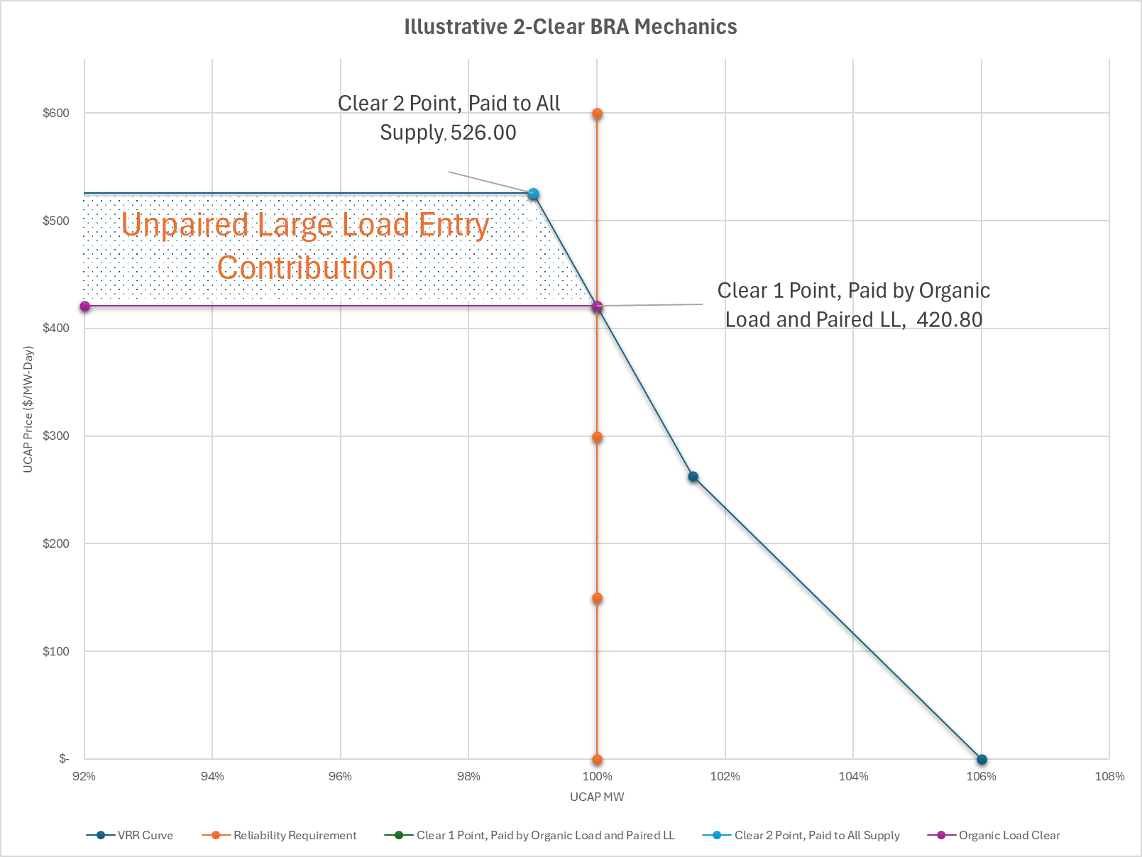
New VRR Clearing Mechanism
Two-Clear Structure to Shield Non-Data Center Load from Price Impacts

Slide 14
Illustrative 2-Clear Auction Revenues Flow
Solely for demonstration of Concept
Numerical Example of Clearing Mechanism
Interactive Table – Double-click to enter calculation mode

Slide 15
Multi-Year Price Lock Mechanism
7-Year Price Lock (ISO-NE Market Design Precedent)
How it works:
Market clears based on new entry in BRA
Subsequent 6 years, resources participate using the PJM NEPA method:
  Units are entered into the auction at the lesser of their initial offer price or 90% times the Net CONE applicable in the first BRA
  If not clearing, the offer price is reduced until all MWs cleared
  Resource is paid uplift from the clearing price to previous offer price
Administrative Backstop to 7-year lock:
Modification to the reliability backstop to allow faster triggering of multi-year contracting with PJM
Avoid dipping more than the Reference Resource UCAP MW below Point A on the VRR curve
  This would move the clearing point back to the inflection point on the VRR curve
This would potentially allow for faster entry of new supply if market response is inadequate

Slide 16
10-Month Expedited Interconnection for New Supply (patterned from Manual 14H, Section 11 Upgrades and PJM proposal)
Straw Proposal for High ELCC Class Resources (>60%), Dispatchable
Key Requirements:
New supply requests commit to fully fund new Network Upgrades necessary to obtain their Capacity Injection Rights (CIRs) and establish their Installed Capacity (ICAP) and Maximum Facility Output (MFO)
Commit to a completion date with sufficient incentives to ensure the completion date is achieved (PJM could look to the RRI commitments and incentive as a model)
Alignment with Issue Charge:
Consistent with Issue Charge Item 3: "Explore potential solutions that include further changes to interconnection rules targeting resource adequacy challenges to the extent they are narrowly focused, such as accelerated queue options, with objective for consensus by EOY 2025"
Like PJM's proposal, will impact the Cycle process
Integration:
Ties to proposed auction clearing mechanism that pairs new loads with supply ability to enter market
* SPP HILLGA process provides a potential alternative track for faster interconnection. See next slide

Slide 17
SPP HILLGA Proposal and DOE ANOPR
Recent developments for consideration interconnecting Large Loads and Paired Generation
SPP High Impact Large Load Generator Assessment (HILLGA)
  Expedited, serial, limited study process – 150 Days
  Geographically restricted (within 1 or 2 substations depending on voltage)
  Significant deposit requirements for generation ($8,000/MW security)
  Limited Interconnection Service with requirement to complete standard IC process for full Network Integration
  Similar to other proposals brought forward in CIFP and may represent alternative fast-path interconnection option
DOE Large Load Advance Notice of Proposed Rulemaking (ANOPR)
  Some key observations:
    Assertion of FERC jurisdiction over large load interconnections with specific discussion of coordination of corresponding entry of new supply (hybrid resources)
    Standardization of study deposits, readiness requirements, and withdrawal penalties.
    Incentives to encourage curtailability of LLs or Hybrids

Slide 18
Benefits vs. Other Proposals
LS Power Approach Advantages
Component | LS Power Proposal | DCC/Governors Proposal | Silver/Glatz | NRDC | PJM Proposal
Load Forecast | Financial commitment requirement, deposit mechanism to ensure accountability | Similar to PJM | LLA attestation and utility feasibility determination | LLAs responsible for self-provision of capacity, isolating existing loads | State Commission review, duplication inquiry
Price Impact Mitigation | Two-clear VRR structure isolates impact to data center load | Extend Price Collar by One Year. Expanded role for DR and additional Curtailment of LLA when paired generation delayed | NCBL mandatory treatment or BYOG offsets capacity price impacts | NCBL mandatory treatment or BYOG offsets capacity price impacts, Curtailment of LLAs reduce energy price impacts | Voluntary PRD/DR
Multi-Year Contracting | Concrete 7-year price lock mechanism with ISO-NE precedent | NA | NA | NA | Exploring backstop acceleration
Generator Incentives | 10-month process + 7-year revenue certainty drives investment | Accelerated Interconnection when paired with LLA | NA | Limited fast interconnection process to serve LLA | 10-month EIT (limited volume)
Cost Allocation | Entry fee and bifurcated pricing protects existing consumers | Extend Price Collar by One Year | Potential different price for new and existing supply | Single price for existing loads, negotiated entry of supply between new LLA and new Supply | No bifurcation
Market Integration | Integrated solution tying load, supply, and interconnection | Focus on expedited interconnection of paired supply | Focus on load growth and restraining LLA | Focus on load growth and restraining LLA | Separate expedited track

Slide 19
Conclusion & Next Steps
A Balanced, Market-Based Solution
LS Power's proposal offers:
✓ Near-term solutions for energy shortage
✓ Long-term framework for capacity scarcity
✓ Consumer protection through cost differentiation
✓ Investment certainty through multi-year mechanisms
✓ Accelerated interconnection for critical resources
✓ Financial accountability for load forecasting
This comprehensive package addresses PJM's unprecedented challenges while maintaining competitive market principles and protecting existing consumers.
We look forward to engagement with the PJM Board as it decides the appropriate path forward in addressing the issues identified in this CIFP Process.

Slide 20
Contact us
Questions?
Dan Pierpont
dpierpont@lspower.com
Tom Hoatson
thoatson@lspower.com

