Slide 1
Gas Scheduling Issues – Operator Communications

Slide 2
Operator Communications
Conversations between PJM and gas unit Generation Owner
  Scheduling unit for current day and next day (after DA)
  Swapping of fuel from gas to oil
June 17, 2014
Similar issues seen during January operations on much wider scale
Actual calls and transcripts (names changed, removed sensitive info)

Slide 3

Operator Communications
Call 1 – 0954 – Inquiry of Notification Time for Blues Unit 1 & 2
  Issue – Notification Time can change on an hourly basis
Call 2 – 0955 – Commitment of unit for current day for Blues Unit 1
  No staffing or gas issues which would show up later in day
Call 3 – 1405 – Staffing/Gas procurement impact on Notification Time
  Implication – Staffing does not impact Notification Time. DA Market clearing impacts Notification Time due to gas procurement
Call 4 - June 17, 2014 1411:14 – Staffing impact on Notification Time
  Implication – Staffing and Notification Time depends on DA Market clearing
Call 5 - June 17, 2014 1851:39 – Request for Staffing and Fuel Swap
  PJM requests staffing (no unit commitment); Unit out of fuel and must come off or swap fuel (9 minute notice)

Slide 4
Operator Communications
Call 6 - June 17, 2014 1904:27 – Inquiry About Fuel Swap
  PJM questions physical operating parameters to perform fuel swap
Call 7 - June 17, 2014 1932:04 – Notification Time Confusion and Commitment for Next Day
  Unit unavailable on gas until 1000 (gas schedule in eMKT was available); Speculation on run time
Call 8 - June 17, 2014 1940:06 Swapping Fuel Schedule
  Confirmation on available schedule for oil
Call 9 - June 17, 2014 1941:32 Confirming Fuel Swap
  Confusion over status of fuel swap
Call 10 - June 17, 2014 1946:03 Confirming Schedule for Next Day
  PJM confirms expected schedule for the next day
Call 11 - June 17, 2014 2306:04 Release of Blues 1 Unit

Slide 5
Issues
Notification Times changing hourly based on staffing? and gas procurement
  Makes timing of commitment decisions difficult
Confusion around process for fuel switching (changing schedule and physical unit limitations)
PJM giving estimates for run time as basis for gas purchases
  “Firmness” of these estimates
Cumbersome nature of unit commitment and fuel switch decision
  11 phone calls for 1 unit

Slide 6

Generator Attributes
Schedule
Unit
Schedule Types
and Selection
Offer Curves
MW Operating Limits
Use Startup & Noload Cost for price-based units
Startup and
Notification times
Min an Max Data
Condenser Data
Hourly
Updates
Unit Status
Resource Type
MW Operating Limits
Ramp Rates
Weather and Wind Forecasts
Startup & No Load Costs for price-
based units
Commit Status
MW Operating Limits
Notification Time

Slide 7
Notification and Startup Times
The following information can be changed on the Schedule Detail page:
Notification Times
The time interval in hours, between PJM notification and the start sequence of a generating unit that is currently in one of three temperature states
Hot Notification Time
  Inter Notification Time
  Cold Notification Time
Startup Times
The time interval, measured in hours, from the actual unit start sequence to the breaker close for
a generating unit in one of the three temperature states
  Hot Startup Time
  Inter Startup Time
  Cold Startup Time

Slide 8
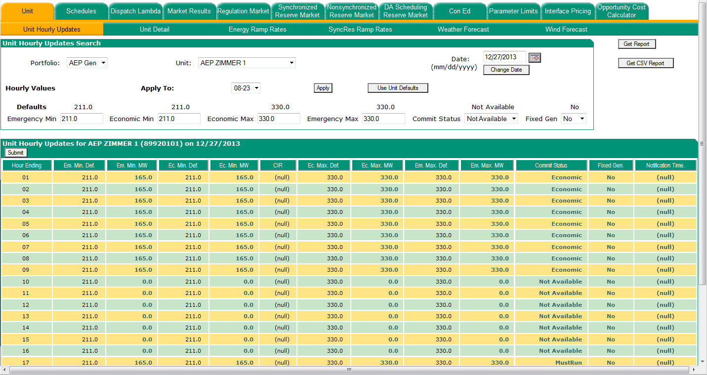
Notification Time - This can override the daily scheduled, Hot, Cold, or Intermediate Notification Times
Can only be changed during real-time operations

Slide 9
Changing Fuel Schedules
Units may be asked by PJM to stay on longer than their
day-ahead schedule
If this extended run forces the unit to procure fuel at a higher cost than their day-ahead offer, they may be reimbursed for these additional costs
Unit owner must inform PJM which fuel cost schedule (#1-69,80-89) they will need to switch to in order to run the additional hours
  If new schedule is economic, PJM operator will switch
  the unit to new schedule and log appropriately
  If new schedule is not economic, PJM operator will
  release the unit and commit a different unit
Notes:
Now let’s discuss the offer curve for a resource.
Read the slide. Then explain we will look at an example of how this is applied.

Slide 10
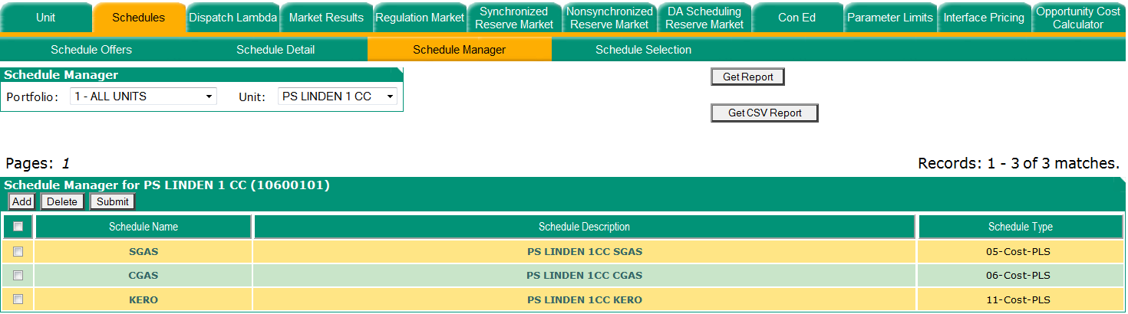
Switching Schedules
If a unit has been asked to extend its hours of operation in real time and the unit has a limited fuel supply and must utilize higher priced fuel to remain online, the participant must inform the PJM system operator of the fuel cost change by requesting the real time offer to be switched to one of the additional available schedules
Give PJM system operator the Schedule Name and Schedule Description from Schedule Manager Page
Lucky Start CT SGAS
Lucky Start CT CGAS
Lucky Start CT Kero

Slide 11
PJM Procedure for Cost Reimbursement
Participants who have been asked by PJM to extend a unit’s run time and in order to comply with that request procured higher cost fuel have until 12:00 noon on the following business day to submit an e-mail to market_bids@pjm.com with the following information:
  Unit Name
  Date of operation
  Time of extended operation
  ID number of new schedule
  Name of new Schedule
  Contact information (name of sender, phone, e-mail)
  Date and time of PJM Dispatch contact to generator
  Actual marginal cost of unit considering the actual cost of the fuel procured to
  continue operating

