Slide 1

Submission of Supplemental Projects for
Inclusion in the Local Plan
AEP Local Plan - 2026

Slide 2

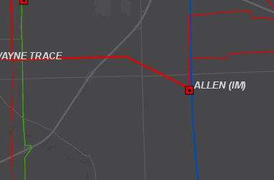
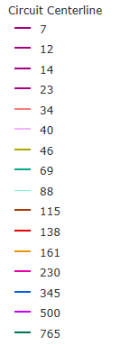
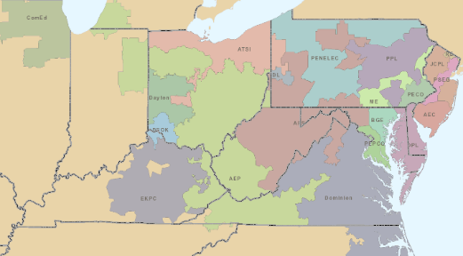
AEP Transmission Zone M-3 Process
New Haven, Indiana
Need Number: AEP-2023-IM026
Process Stage: Submission of Supplemental Project for inclusion in the Local Plan 01/09/2026
Previously Presented: Need Meeting 09/20/2024, 12/15/2023; Solution Meeting 11/06/2024
Project Driver: Customer Service
Specific Assumption References:
AEP Interconnection Guidelines (AEP Assumptions Slide 12)
Problem Statement:
A customer has requested a new delivery point in New Haven Indiana for up to 480 MW by November 2026. This customer will begin to increase this load from 480MW to 1200MW by July 2029.
AEP Local Plan 2026
2
Notes:
Use this template for Needs slides.

Slide 3
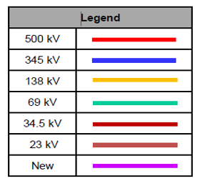
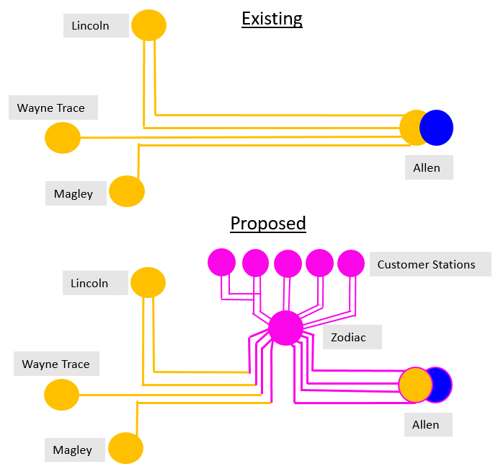
AEP Transmission Zone M-3 Process
New Haven, Indiana
Need number(s): AEP-2023-IM026
Process Stage: Submission of Supplemental Project for inclusion in the Local Plan 01/09/2026
Proposed Solution:
Allen Station: Expand Allen station with 2x additional 345/138kV transformers. Install 3x 345kV breaker and 3x 138kV breaker for transformer protection. Land purchase for station expansion is included. The transformers are added for overloads identified under N-1-1 analysis for loss of Robison Park Transformer #5 and Allen Transformer #2, or N-1-1 loss of both existing transformers at Allen station.. Estimated Cost: $58.5 M (s3750.1)
Zodiac Station: Install greenfield 138kv breaker and a half station. Zodiac 138kV station will include 8-138kV AEP circuit exits and customer terminations to 5 customer buildings. . Estimated Cost: $38.1 M (s3750.2)
Allen-Zodiac 138kV Lines: Cut into 2x existing double circuit 138kV lines, (4x circuits total) and install 4x double circuit 0.2 mile extension to new Zodiac 138kV station. Rebuild both ~3.7 mile 138kV double circuit lines from Allen-Zodiac Station (~7.4 mile double circuit total).. Estimated Cost: $44 M (s3750.3)
Customer Radials: Install 5x double circuit 138kV ~0.75 mile radials to customer owned stations from Zodiac station with fiber. . Estimated Cost: $28.5 M (s3750.4)
Transmission Cost Estimate: $169.1 M
AEP Local Plan 2026
3
Notes:
Use this template for Needs slides.

Slide 4
AEP Transmission Zone M-3 Process
New Haven, Indiana
Need number(s): AEP-2023-IM026
Process Stage: Submission of Supplemental Project for inclusion in the Local Plan 01/09/2026
Alternatives Considered:
A project alternate would be to serve the customer off 345kV at Allen station instead of the 138kV. This would ultimately include an Allen station expansion with 3x 345kV breakers, ~3.7 miles of greenfield double circuit 345kV from Allen station to Zodiac station. The greenfield Zodiac station would be comprised of a high side 8x 345kV breaker and a half, 4x 345/138kV step down transformers and 18x 138kV low side breaker and a half. Customer radials from Zodiac would still be required. Due to the time required for 345kV greenfield, the higher loadings on the 345k with this alternate, and the customer’s site location being adjacent to existing 138kV this alternate was not chosen.
Project Alternate Cost: $214M
Supplemental Project ID: s3750.1-4
Projected In-Service: 07/01/2029
Project Status: Scoping
AEP Local Plan 2026
4
Notes:
Use this template for Needs slides.

Slide 5
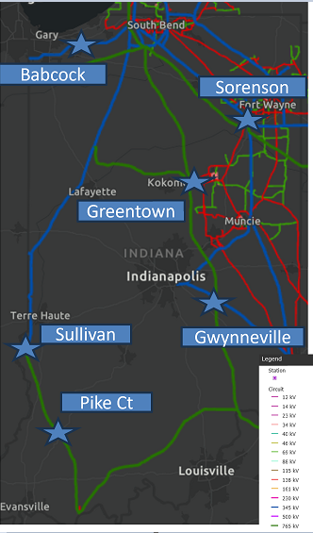
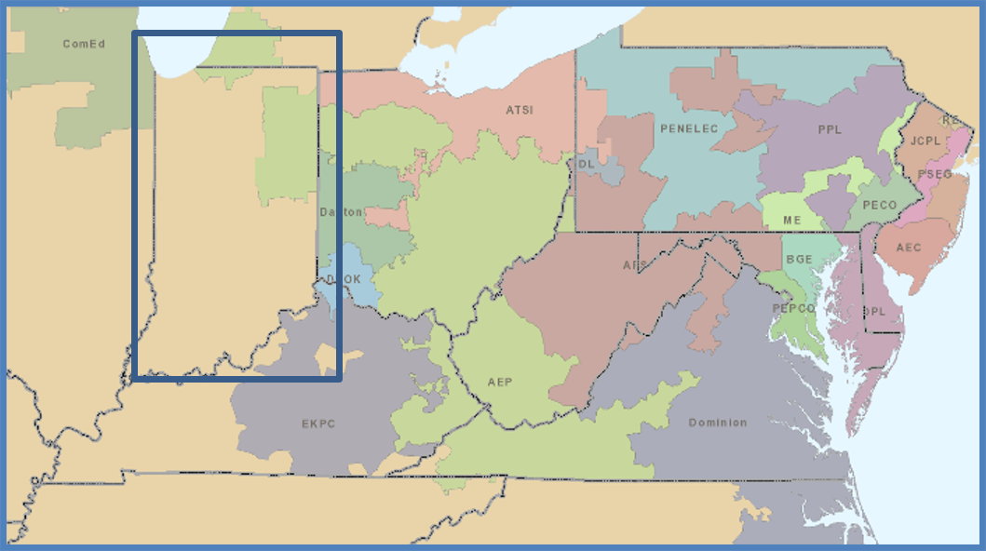
AEP Transmission Zone M-3 Process
Greentown, IN
Need Number: AEP-2024-IM018
Process Stage: Submission of Supplemental Project for inclusion in the Local Plan 1/22/2026
Previously Presented: Need Meeting – 12/03/2024; Solutions Meeting: 03/04/2025
Supplemental Project Driver: Other
Specific Assumption Reference: Other Requests - AEP Assumptions Slide 16
Problem Statement:
The following needs are the result of MISO’s request to connect certain portions of their Tranche 2 projects to the PJM transmission system via several AEP locations. Because these MISO requests may result in potential PJM system impacts, AEP is bringing these through the M-3 process to allow PJM to conduct do-no-harm analysis and identify potential planning criteria violations caused by the MISO requests. AEP at this point has not identified any large-scale issues resulting from the MISO proposals.
• MISO has requested two new 345kV line interconnections into AEP’s Sullivan station from Fairbanks 345kV and Dresser 345kV. To facilitate this, work will be needed at the PJM Sullivan 765/345kV station.
• MISO has requested two new 765kV line interconnections into AEP’s Sorenson station from Greentown 765kV and Lulu 765kV. To facilitate this, work will be needed at the PJM Sorenson 765/345/138kV station.
• MISO has requested a new 765KV substation on the Rockport – Sullivan 765kV line. To facilitate this station, work will be needed on the Rockport – Sullivan 765kV PJM asset.
• MISO has requested a new station to be constructed to tie the Jefferson – Greentown 765 and the Hanna – Tanners Creek 345kV lines together into a new “Gwynneville” 345kV substation. To facilitate this, work will be needed on the Jefferson – Greentown 765kV PJM asset and the Hanna – Tanners Creek 345kV PJM asset.
• MISO has requested cutting the Olive – University Park 345kV and Olive – Green Acres 345 kV lines into the existing Babcock 345kV substation. To facilitate this, work will be needed on the Olive – University Park/Green Acres double circuit 345kV line.
• MISO requested an in-service date of 06/01/2032.
AEP Local Plan 2026
5
Notes:
Use this template for Needs slides.

Slide 6
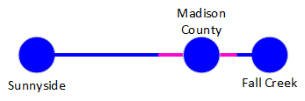

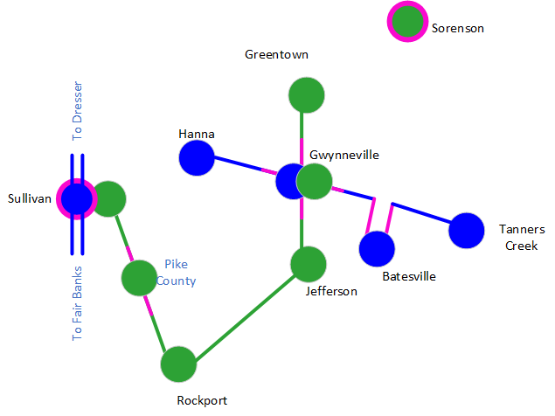
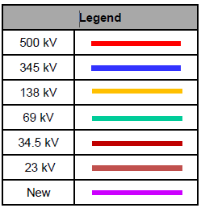
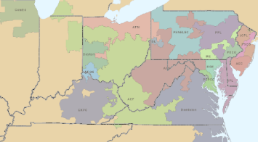
AEP Transmission Zone M-3 Process
MISO Tranche 2 Projects
Need Number: AEP-2024-IM018
Process Stage: Submission of Supplemental Project for inclusion in the Local Plan 1/22/2026
Proposed Solution:
Sorenson Station
At Sorenson 765kV Station, modify Sorenson station to interconnect new 765kV lines Sorenson-Greentown 765kV and Sorenson-Lulu 765kV.(s3608.5)
Sullivan Station
At Sullivan 345kV station, modify Sullivan 345kV to interconnect new 345kV lines Sullivan-Fairbanks 345kV #1, Sullivan-Fairbanks #2, Sullivan-Dresser 345kV #1, Sullivan-Dresser 345kV #2. (s3608.6)
Sullivan – Rockport 765kV Line
Modify the existing Sullivan-Rockport 765kV line for greenfield Pike County station to cut in. (s3608.1)
Jefferson – Greentown 765kV Line
Modify the existing Jefferson-Greentown 765kV line for Gwynneville station to cut in. (s3608.2)
Tanners Creek – Hanna 345kV Line
Modify the existing Tanners Creek - Hanna 345kV line for Gwynneville station to cut in.
Modify the future Gwynneville-Tanners Creek 345kV line for existing station Batesville to cut in. (s3608.3)
Existing
Proposed
765kV
AEP Local Plan 2026

Slide 7
AEP Transmission Zone M-3 Process
MISO Tranche 2 Projects
Existing
Proposed
Need Number: AEP-2024-IM018
Process Stage: Submission of Supplemental Project for inclusion in the Local Plan 1/22/2026
Proposed Solution Continued:
Fall Creek – Sunnyside 345kV Line
Modify the existing Fall Creek- Sunnyside 345kV line for greenfield Madison County station to cut in. (s3608.7)
Olive – University Park, Olive –Green Acres 345kV Line
Modify the existing double circuit 345kV line Olive-University Park and Olive-Green Acres 345kV to cut into Babcock 345kV station. (s3608.4)
Total Cost: $173M (MISO), $0M (PJM)
Alternatives Considered: Alternatives considered as part of MISO LRTP process: MTEP24 Chapter 2 - Regional Long Range Transmission Planning658124.pdf
Supplemental Project ID: s3608.1-7
Projected In-Service: 2032-2034
Project Status: Scoping
765kV
AEP Local Plan 2026

Slide 8
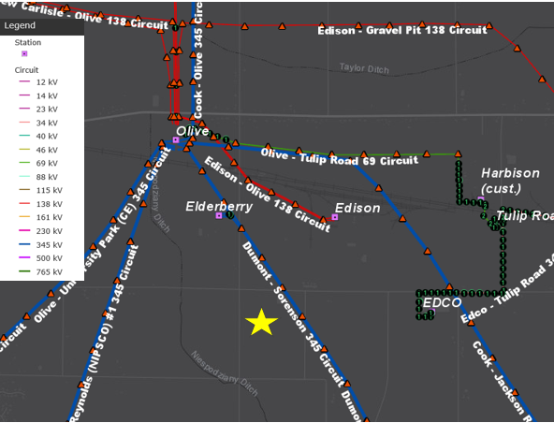
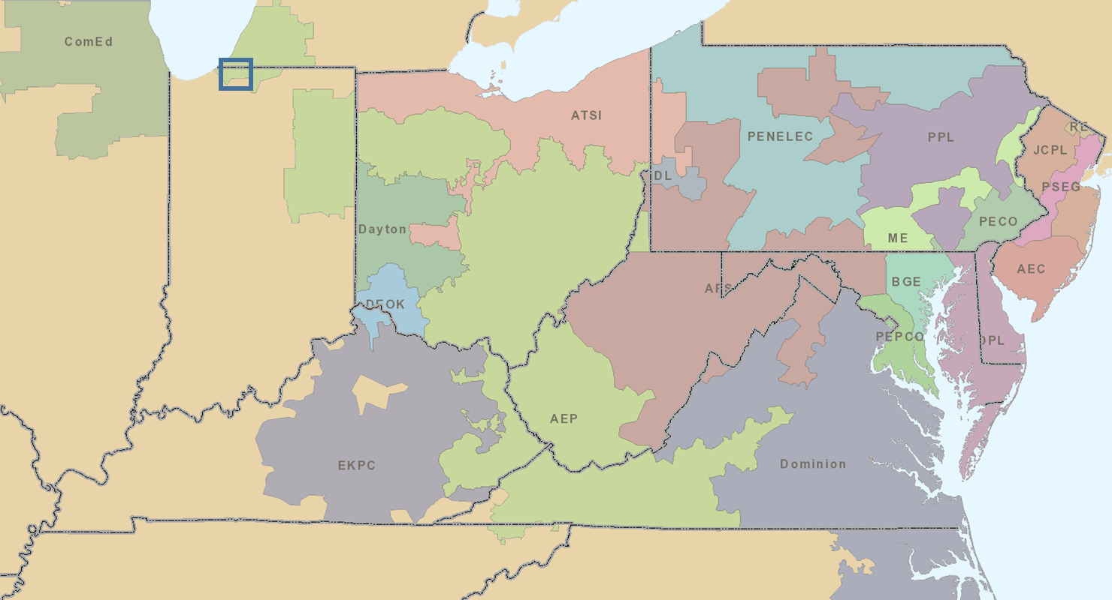
AEP Transmission Zone M-3 Process
New Carlisle, IN
Need Number: AEP-2024-IM016
Process Stage: Submission of Supplemental Project for inclusion in the Local Plan 2/12/2026
Previously Presented: Need Meeting 11/06/2024, Solution Meeting TEAC - 04/01/2025
Project Driver: Customer Service
Specific Assumption Reference: AEP Interconnection Guidelines (AEP Assumptions Slide 12)
Problem Statement:
A customer has requested new service for 437MW of load in the New Carlisle, IN area. Initial service is requested by 3/15/2027.
AEP Local Plan 2026
8
Notes:
Use this template for Needs slides.

Slide 9
AEP Transmission Zone M-3 Process
New Carlisle, IN
Need number(s): AEP-2024-IM016
Process Stage: Submission of Supplemental Project for inclusion in the Local Plan 2/12/2026
Proposed Solution:
Navistar 345kV Station: Construct a new station in a breaker and a half configuration consisting of eleven (11) 345kV 5000A 63kA breakers, two (2) 345kV meters, and station fiber cable to serve 437MW of new load. Construct two (2) 345kV bus ties from AEP's Navistar 345kV station to the customer station. Cut in the Dumont - New Prairie #1 and #2 345kV circuits into the new station.. Estimated Cost: $50.364 M (s3763.1)
Transmission Cost Estimate: $50.364 M
Alternatives Considered:
Considering the location of the requested load and availability of land on the customer site, no other alternates were viable. Expanding other stations in the area to accommodate the additional load was not viable due to customer plans for the space around the other stations.
Supplemental Project ID: s3763.1
Projected In-Service: 03/15/2027
Project Status: Scoping
Existing
Olive
Elderberry
Larrison Drive
New Prairie
Dumont
Proposed
Olive
Elderberry
Larrison Drive
New Prairie
Navistar
Dumont
AEP Local Plan 2026

Slide 10
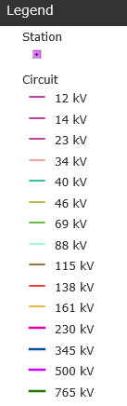
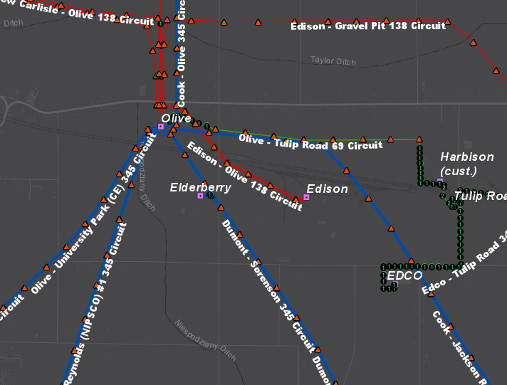
AEP Transmission Zone M-3 Process
New Carlisle Customer Needs
Need Number: AEP-2023-IM020
Process Stage: Submission of Supplemental Project for inclusion in the Local Plan 2/12/2026
Previously Presented: Need Meeting 10/20/2023, Solution Meeting SRRTEP-W - 04/11/2025
Supplemental Project Driver: Customer Service
Specific Assumptions Reference: AEP Interconnection Guidelines (AEP Assumptions Slide 7)
Problem Statement:
A customer has requested new service for a 90 MW manufacturing facility in New Carlisle, IN area.
Requested In Service Date: 5/9/2028.
AEP Local Plan 2026
10

Slide 11
AEP Transmission Zone M-3 Process
New Carlisle Customer Needs
Need number(s): AEP-2023-IM020
Process Stage: Submission of Supplemental Project for inclusion in the Local Plan 2/12/2026
Proposed Solution:
Fillmore Road 138kV Station: Construct a new station in a ring bus configuration consisting of six (6) 138kV 3000A 40kA breakers, three (3) 138/13.8kV 50 MVA LTC transformers, three (3) 13.8kV meters and other associated distribution equipment, and station fiber cable to serve 90MW of new load. Cut into the Olive - Edison 138kV line and construct 2.8 miles of new double circuit 138kV line to the new station.. Estimated Cost: $11.355 M. (s3764.1)
Olive 138kV Station: Bring the Edison - Creek Walker 138kV line into Olive station and install three (3) new 138kV 3000A 63kA breakers to complete the "K" string and create a new line exit position.. Estimated Cost: $19.108 M. (s3764.2)
Transmission Cost Estimate: $30.463 M
Alternatives Considered:
Considering the location of the requested load and availability of land on the customer site, no other alternates were viable.
Supplemental Project ID: s3764.1-2
Projected In-Service: 05/09/2028
Project Status: Scoping
Existing
Olive
Creek Walker
Edison
Proposed
Olive
Creek Walker
Fillmore Road
Edison
AEP Local Plan 2026
11

Slide 12
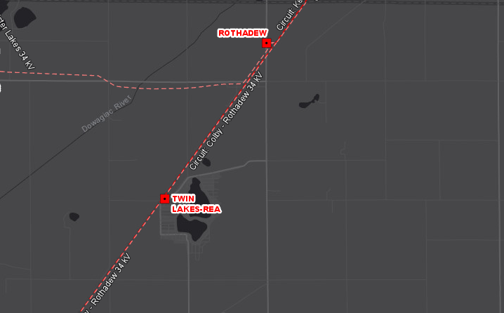
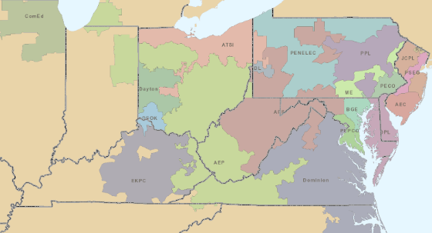
AEP Transmission Zone M-3 Process
Dowagiac, MI
Need Number: AEP-2024-IM011
Process Stage: Submission of Supplemental Project for inclusion in the Local Plan 2/12/2026
Previously Presented: Need Meeting 04/19/2024, Solution Meeting SRRTEP-W - 07/18/2025
Project Driver: Customer Service
Specific Assumption Reference: AEP Connection Requirements for the AEP Transmission System (AEP Assumptions Slide 12)
Problem Statement:
Wolverine Power Supply Cooperative, Inc. has requested a new 138kV delivery point in Dowagiac, Michigan by December 1st, 2025. Anticipated load is approximately 5.14 MVA.
AEP Local Plan 2026
12
Notes:
Use this template for Needs slides.

Slide 13
AEP Transmission Zone M-3 Process
Dowagiac, MI
Need number(s): AEP-2024-IM011
Process Stage: Submission of Supplemental Project for inclusion in the Local Plan 2/12/2026
Proposed Solution:
Hassle Switch 138kV: Cut into the Kenzie Creek - Valley 138kV line and install a new 138kV phase over phase switch to serve approximately 5.14 MVA of new load. AEP will own the first span to the structure inside the customer's station. Fiber will be installed on the new line and metering will be installed on the low side of the transformer.. Estimated Cost: $3.719 M. (s3765.1)
Transmission Cost Estimate: $3.719 M
Alternatives Considered:
Considering the location of the customer request and availability of land for the switch, no other viable alternatives were identified.
Supplemental Project ID: s3765.1
Projected In-Service: 12/01/2025
Project Status: Engineering
Existing
Colby
Valley
Proposed
Colby
Glenwood (MEC)
Hassle Switch
Valley
AEP Local Plan 2026
13
Notes:
Use this template for Needs slides.

Slide 14
Revision History
01/22/2026 – V1 Added slides #1-7: s3750.1-4, s3608.1-7.
02/12/2026 – V2 Added slides #8-xx: s3762.1., s3763.1, s3764.1-2, s3765.1.
03/03/2026 – V3 removed s3762.1 relevant slides due to AEP-2024-OH039 idvs correction.
AEP Local Plan 2026

