Slide 1
Market Efficiency Update
Nick Dumitriu
Sr. Lead Engineer, Market Simulation
Transmission Expansion Advisory Committee January 6, 2021

Slide 2
2020/21 Long Term Window

Slide 3
2020/21 Long-Term Window
Long-Term Market Efficiency Window
2020/21 Market Efficiency Window to open January 11, 2020 (120-days January – May )
Window process and preliminary congestion drivers presented at the Special TEAC – Market Efficiency on December 23rd, 2020
The problem statement, target congestion drivers, and modeling data will be posted when the Long-Term Window opens
Includes updated market efficiency base case files for all study years, PROMOD input files and benchmark test cases and results.
To access the information, stakeholders required to have CEII confirmation (for both PJM and MISO) and PROMOD vendor (ABB) confirmation.
PJM TEAC – 01/06/2021 | Public

Slide 4
Updated ME Base Case - Congestion Changes
Constraint | From Area | To Area | Comment
Maliszewski Transformer 765/138 kV | AEP | AEP | Existing Maliszewski series reactor eliminates congestion.
Cherry Run to Morgan 138 kV | APS | APS | Congestion eliminated by the reliability upgrade B3240 (upgrade Cherry Run and Morgan terminals).
Gore to Stonewall 138 kV | APS | APS | Congestion eliminated by the reliability upgrade B3242 (reconfigure Stonewall substation).
Muskingum River to Waterford 345 kV | AEP | AEP | Congestion eliminated after applying to the ME Base Case the 2x rating multiplier used by PJM Operations. (See AEP’s list of facilities that continue to operate with a 2x rating multiplier https://www.pjm.com/-/media/committees-groups/committees/teac/2020/20201201/20201201-item-06-aep-supplemental.ashx)
Brambleton to Evergreen Mills 230 kV | DOM | DOM | Congestion eliminated by the reliability upgrades B3300 and B3301 (rebuild Brambleton to Evergreen Mills 230kV lines #2172 and #2210).
Quad Cities to Rock Creek 345 kV | COMED | ALTW | Congestion eliminated after applying to the ME Base Case the closed breaker ratings used by PJM Operations.
PJM TEAC – 01/06/2021 | Public
Notes:
Quad cities has some congestion remaining, not eliminated, 0.03 in 2025, 0.34 in 2028

Slide 5
2020/21 RTEP Long-Term Window - Congestion Drivers
2020/21 RTEP Market Efficiency Window Eligible Congestion Drivers |  |  | ME Base Case (Annual Congestion $million) |  | ME Base Case (Hours Binding) |  | Comment
Constraint | From Area | To Area | 2025 Simulated Year | 2028 Simulated Year | 2025 Simulated Year | 2028 Simulated Year
Kammer North to Natrium 138 kV | AEP | AEP | $ 2.60 | $ 13.19 | 102 | 244 | Internal Flowgate
Muskingum River to Beverly 345 kV | AEP | AEP | $ 1.00 | $ 2.21 | 113 | 187 | Internal Flowgate
Junction to French's Mill 138 kV | APS | APS | $ 18.45 | $ 25.88 | 510 | 634 | Internal Flowgate
Yukon to AA2-161 Tap 138 kV | APS | APS | $ 4.30 | $ 5.37 | 1740 | 2059 | Internal Flowgate
Charlottesville to Proffit Rd Del Pt 230 kV | DOM | DOM | $ 3.93 | $ 4.21 | 129 | 115 | Internal Flowgate
Plymouth Meeting to Whitpain 230 kV | PECO | PECO | $ 5.44 | $ 7.27 | 154 | 153 | Internal Flowgate
Cumberland to Juniata 230 kV¹ | PLGRP | PLGRP | $ 8.70 | $ 9.07 | 233 | 216 | Internal Flowgate
Harwood to Susquehanna 230 kV^{1,2} | PLGRP | PLGRP | $ 16.73 | $ 12.40 | 949 | 723 | Internal Flowgate
Duff to Francisco 345 kV | DUK-IN | DUK-IN | $ 0.96 | $ 3.82 | 81 | 125 | M2M
Gibson to Francisco 345 kV |  |  | $ 4.28 | $ 3.71 | 198 | 211
Notes:
1) Cumberland – Juniata and Harwood – Susquehanna Congestion drivers may be impacted by DLR (Dynamic Link Rating) projects
(Expected in-service date 06/01/2021).
2) Harwood – Susquehanna simulated congestion is $23.1 million in 2031. Driver may be impacted by recently announced Talen Energy retirements. (Retirement notice not submitted to PJM).
https://talenenergy.investorroom.com/2020-11-10-Talen-Energy-Announces-Transformational-Move-Toward-a-Sustainable-ESG-Focused-Future
PJM TEAC – 01/06/2021 | Public

Slide 6
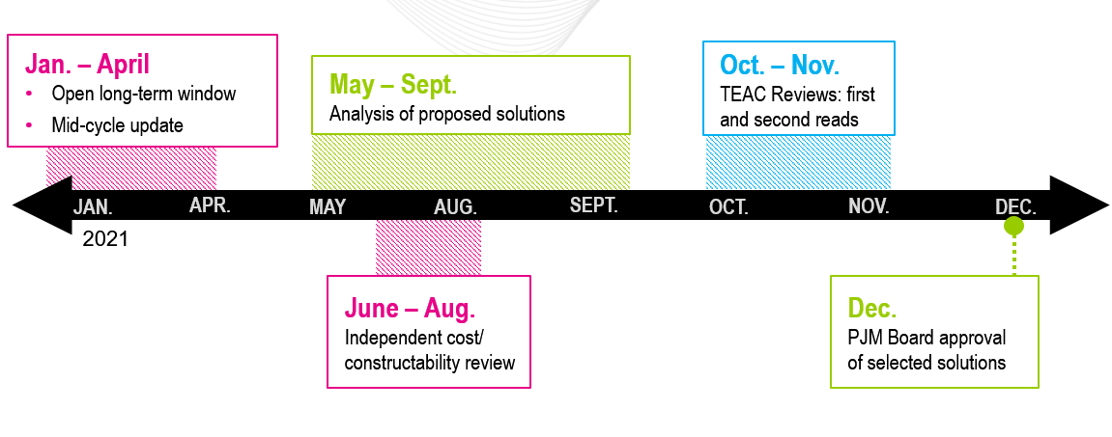
2020/21 Long-Term Window Schedule
PJM TEAC – 01/06/2021 | Public
Notes:
jan-may?

Slide 7
2020/21 Long-Term Window
Registration Process
PJM TEAC – 01/06/2021 | Public

Slide 8
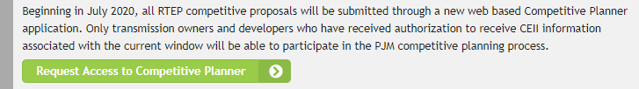
Market Efficiency RTEP Window Registration
Beginning July 2020, all RTEP competitive proposals are submitted through a new web-based Competitive Planner application.
Only transmission owners and developers who have received authorization to receive CEII information associated with the current window will be able to participate in the PJM competitive planning process.
Register for the 2020/21 RTEP Market Efficiency Window at PJM.com > Planning > Competitive Planning Process
In the CEII Request form write “Access to the 2020/21 Long Term RTEP Window” as the description of the information requested.
All participants must register to access the data regardless of prior participation in the PJM Competitive Process.
PJM TEAC – 01/06/2021 | Public

Slide 9
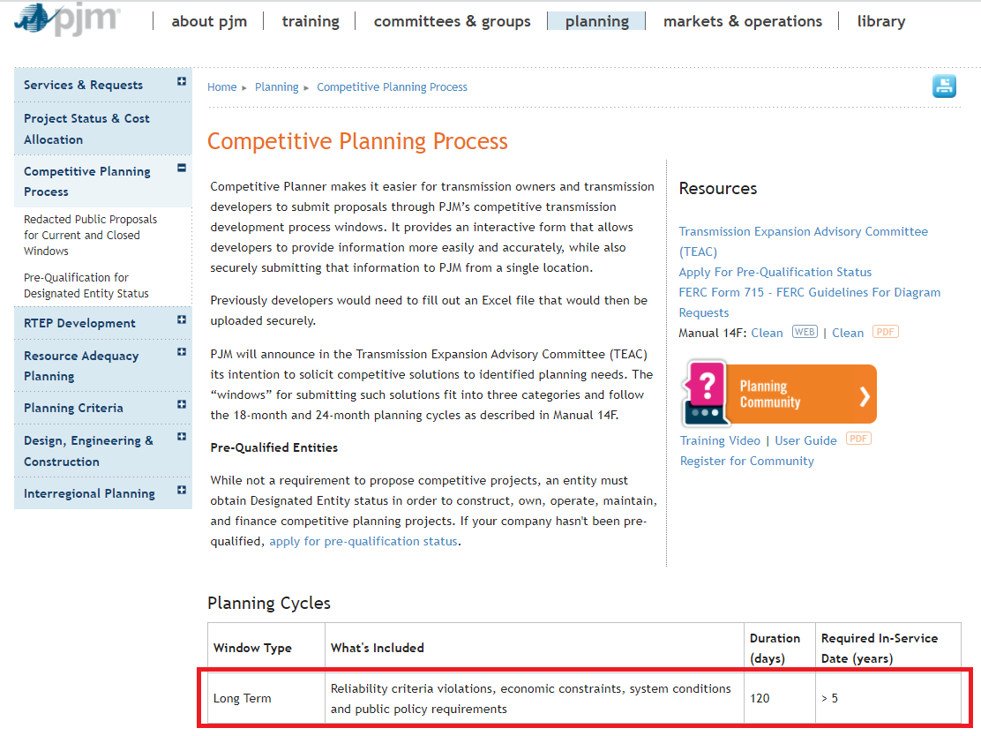
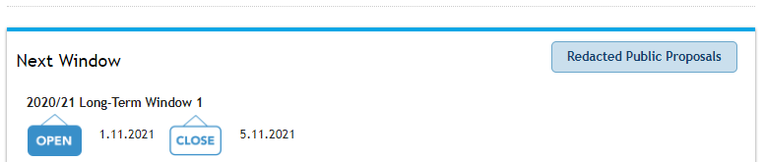
RTEP Window Registration Screenshot
PJM TEAC – 01/06/2021 | Public

Slide 10
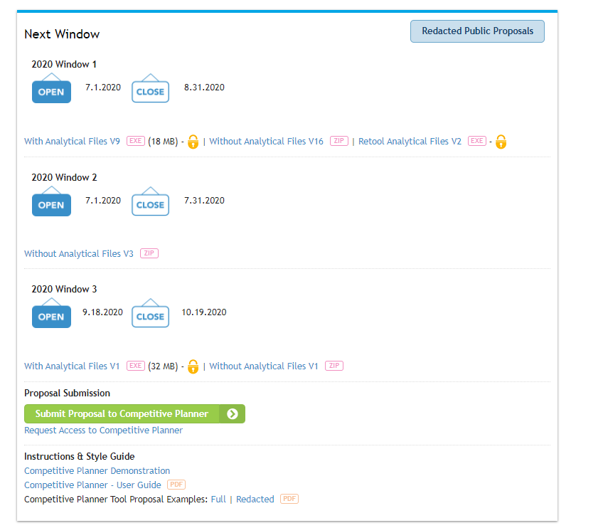

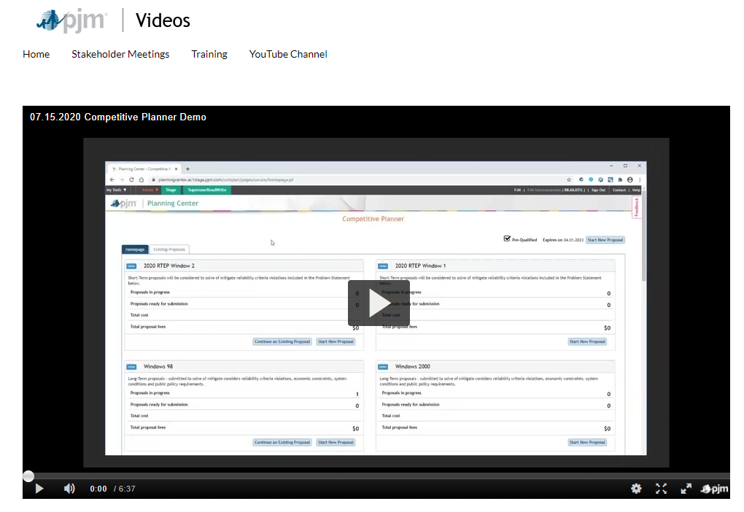
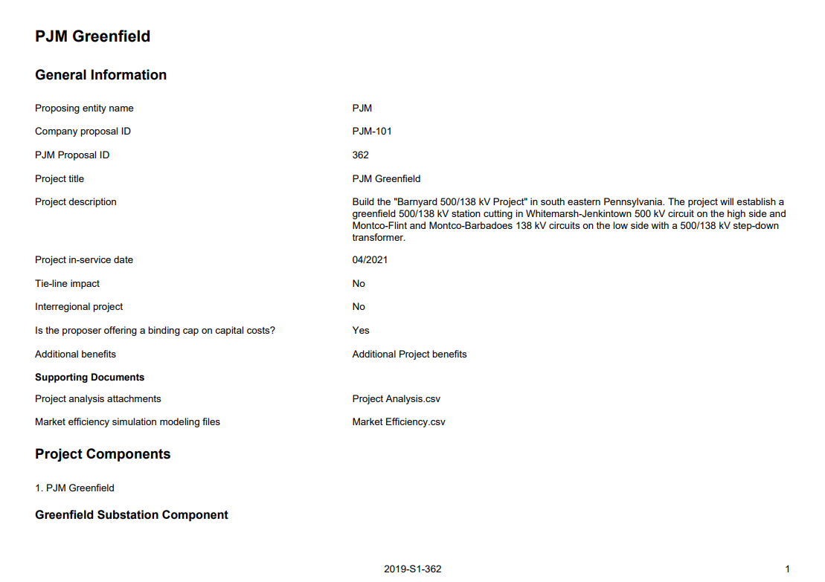
Competitive Planner Tool Training Materials
PJM has a Users Guide posted to the PJM website for the new Competitive Planner Tool:
PJM.com > Planning > Competitive Planning
Process > Competitive Planner – User Guide
There is also a demonstration Video posted to the PJM website showing how to use the new Competitive Planner Tool:
Videos.pjm.com > Competitive Planner Demo
PJM has also posted Examples of Competitive Planer proposals:
PJM.com > PJM.com > Planning > Competitive Planning Process > Competitive Planner Tool Proposal Examples: Full | Redacted
PJM TEAC – 01/06/2021 | Public

Slide 11
Conclusion of 2020 Reevaluation and Acceleration Analyses
PJM TEAC – 01/06/2021 | Public

Slide 12
2020 Reevaluation and Acceleration Analyses
2020 Acceleration Analysis completed and results presented at TEAC Special Session – Market Efficiency on December 23rd, 2020
  https://www.pjm.com/-/media/committees-groups/committees/teac/2020/20201223-special/20201223-item-02-annual-acceleration-analysis.ashx
  RTEP upgrade B3157 was selected for acceleration from 12/1/2024 to 12/31/2021
    upgrade of substation equipment at APS Messick Rd and Morgan 138 kV (cost $.23 million)
    shows significant congestion benefits if accelerated before year 2024.
    Acceleration cost: 0$
2020 Reevaluation Analysis completed and results presented at TEAC Special Session – Market Efficiency on December 23rd, 2020
  https://www.pjm.com/-/media/committees-groups/committees/teac/2020/20201223-special/20201223-item-03-reevaluation-report-iec-9a-project.ashx
PJM TEAC – 01/06/2021 | Public

Slide 13

Contact
Facilitator:
Sue Glatz, Suzanne.Glatz@pjm.com
Secretary:
Michael Zhang, Michael.Zhang@pjm.com
SME/Presenter:
Nick Dumitriu, Nicolae.Dumitriu@pjm.com
Market Efficiency Update
Member Hotline
(610) 666 – 8980
(866) 400 – 8980
custsvc@pjm.com

Slide 14
Revision History
V1 – 12/28/2020 – Original slides posted
V2 – 01/05/2021
  Inserted slide 4, Updated ME Base Case - Congestion Changes
  Inserted slide 5, 2020/21 RTEP Long-Term Window - Congestion Drivers
  Slide 9 – Updated web page screenshot
V3 – 02/04/2021
  Slide 12 – Added details for RTEP upgrade B3157 selected for acceleration

