Slide 1
2025 RTEP Report
Key Maps, Tables & Figures
The following set of slides provides key information from PJM’s 2025 RTEP cycle. The slides are provided for the reader’s own communications needs.

Slide 2
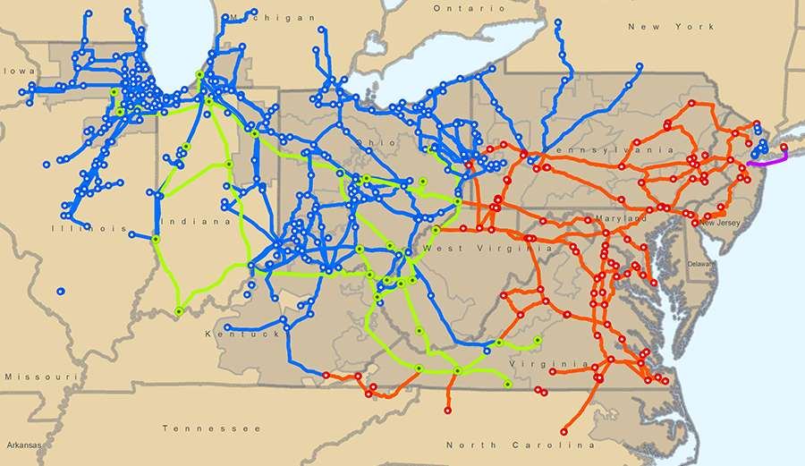
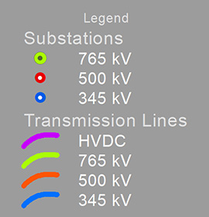
PJM Backbone Transmission System

Slide 3
Board-Approved RTEP Projects
(as of Dec. 31, 2025)

Slide 4
PJM Existing RPM-Eligible Installed Capacity Mix
As of Dec. 31, 2025

Slide 5
Interconnection Service Request Generation
Fuel Mix – Requested Capacity Interconnection Rights
As of Dec. 31, 2025

Slide 6
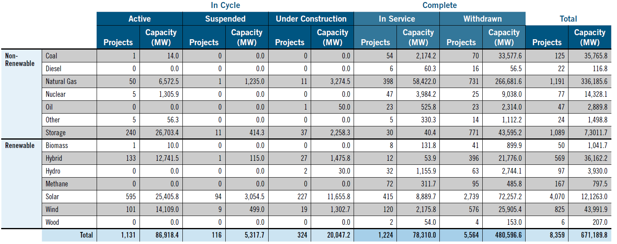
Requested Capacity Interconnection Rights,
Non-Renewable and Renewable Fuels (Dec. 31, 2025)

Slide 7
Interconnection Service Study Requests
(Dec. 31, 2024)

Slide 8
2024 RTEP Baseline Project Drivers ($ Million)

Slide 9
Impact of Electrification and Data Center Load on Forecasts

Slide 10
Summer Peak Load Forecast 2025 vs. 2024

Slide 11
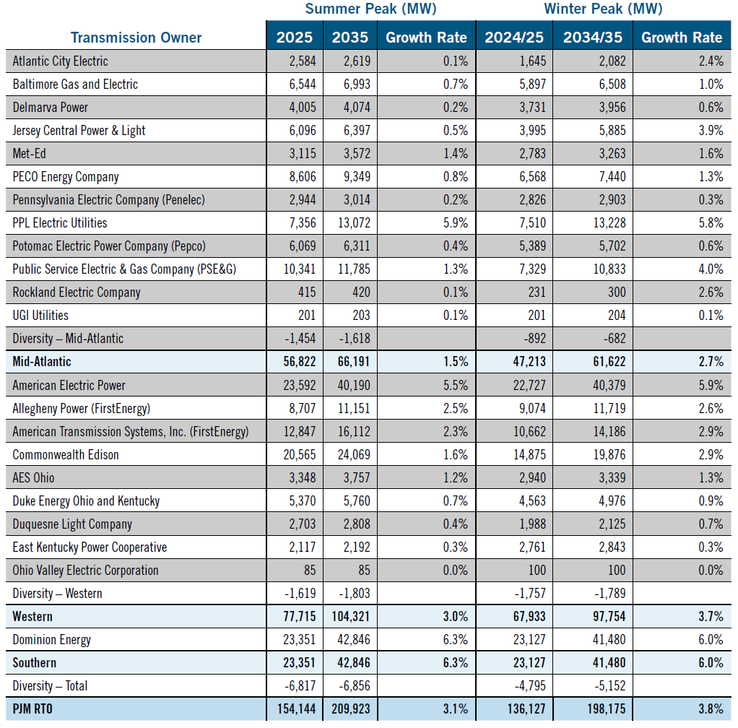
2025 Long-Term Load Forecast Report: Summer and Winter Peaks

Slide 12
PJM 10-Year Summer Peak Load Growth Rate Comparison
2021–2025 Long-Term Load Forecast Reports

Slide 13
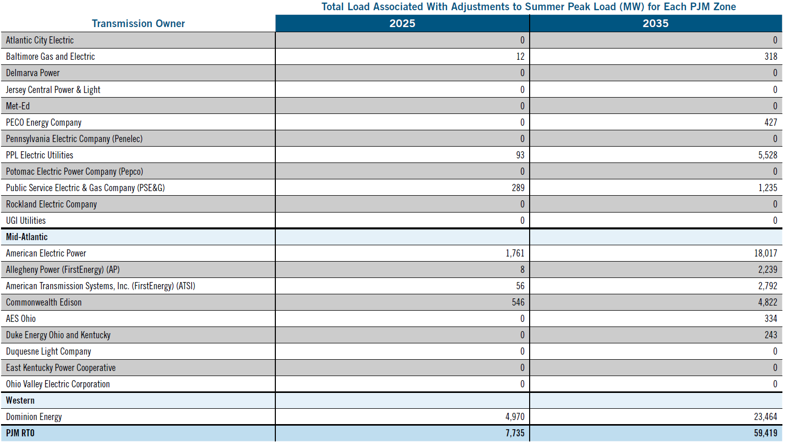
2025 Long-Term Load Forecast Report:
Large Load Adjustments in 2025 and 2035

Slide 14
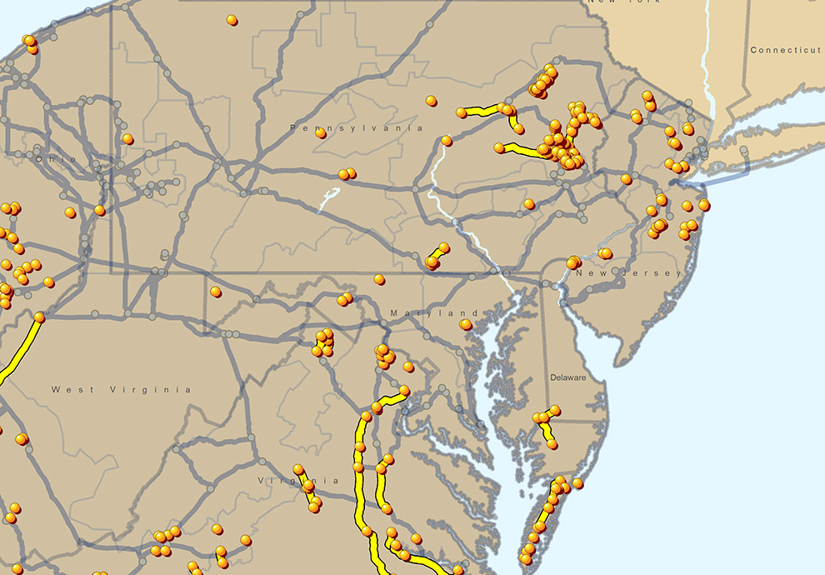
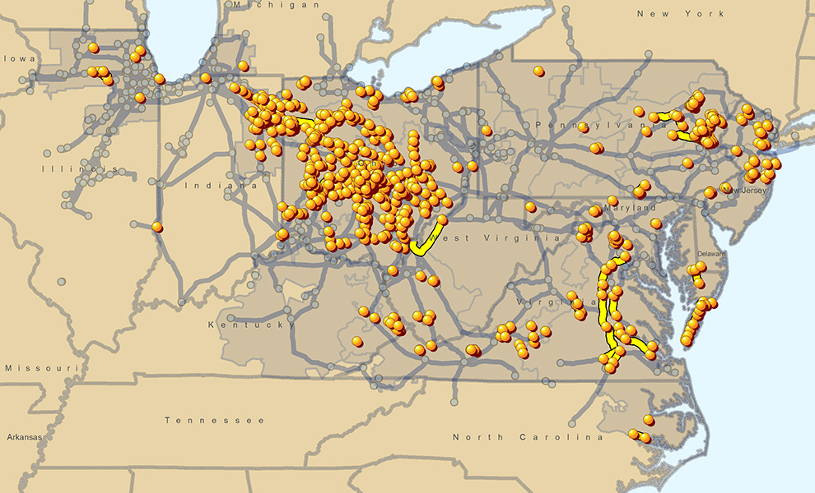
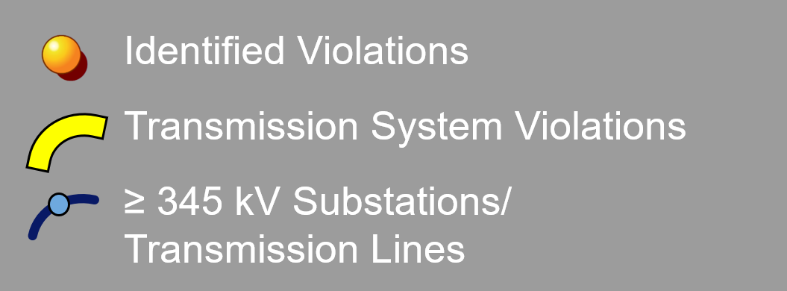
2025 RTEP Baseline Thermal and Voltage Criteria Violations –
Mid-Atlantic – Study Years 2030 and 2032

Slide 15
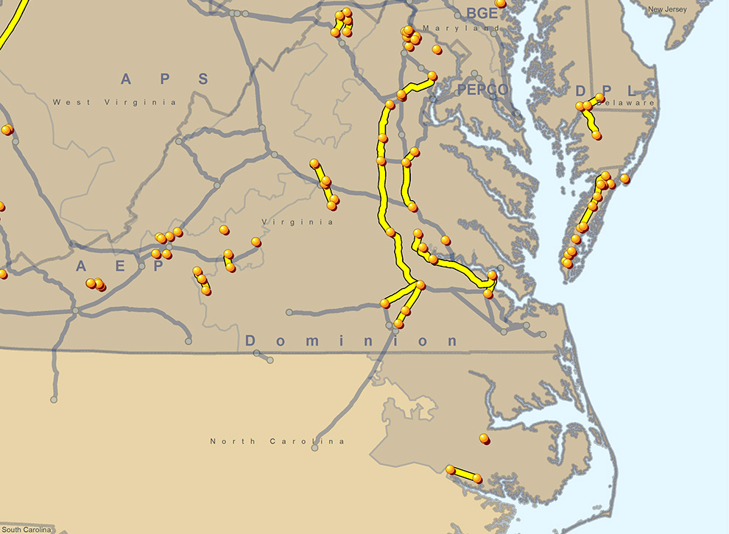
2025 RTEP Baseline Thermal and Voltage Criteria Violations –
South – Study Years 2030 and 2032

Slide 16
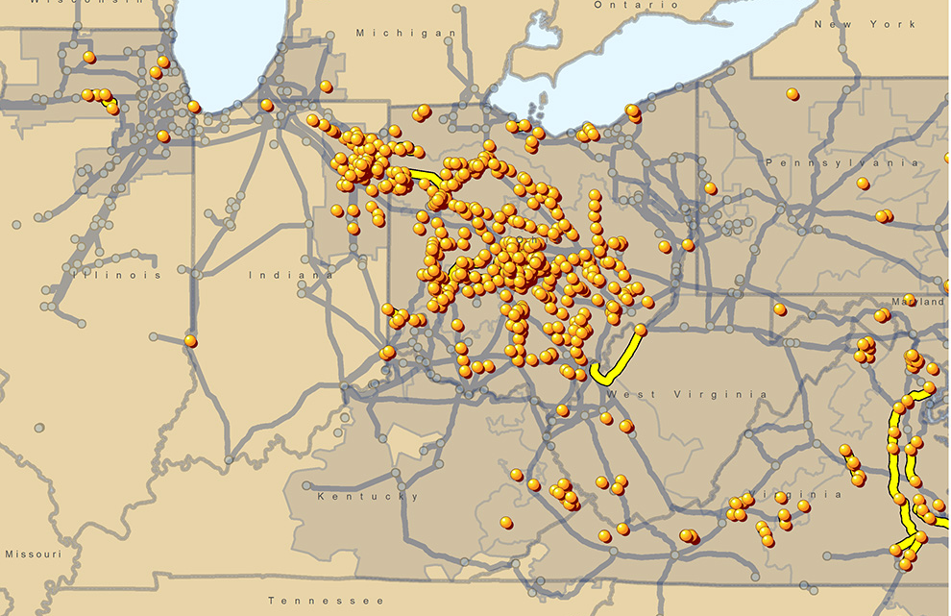
2025 RTEP Baseline Thermal and Voltage Criteria Violations –
West – Study Years 2030 and 2032

Slide 17
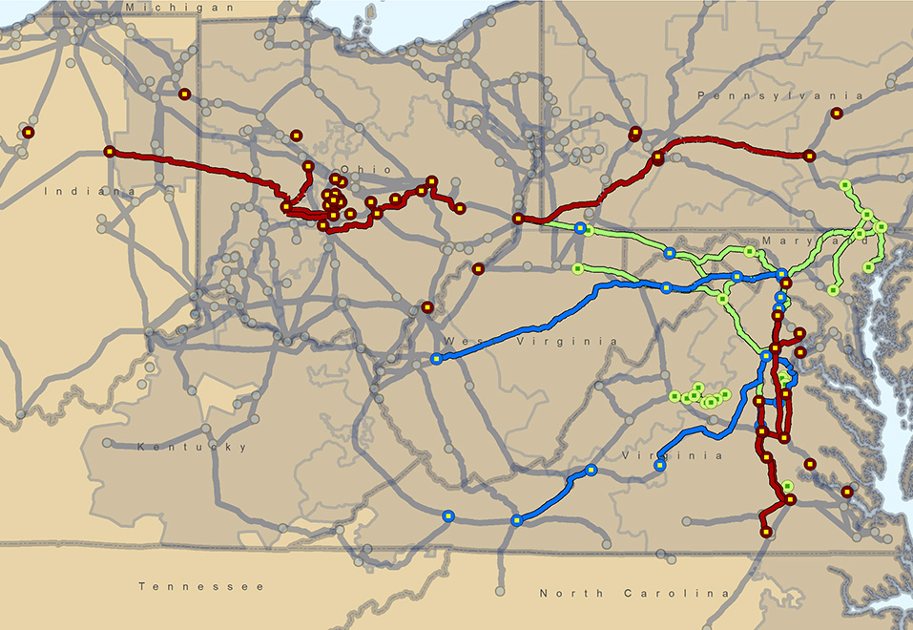
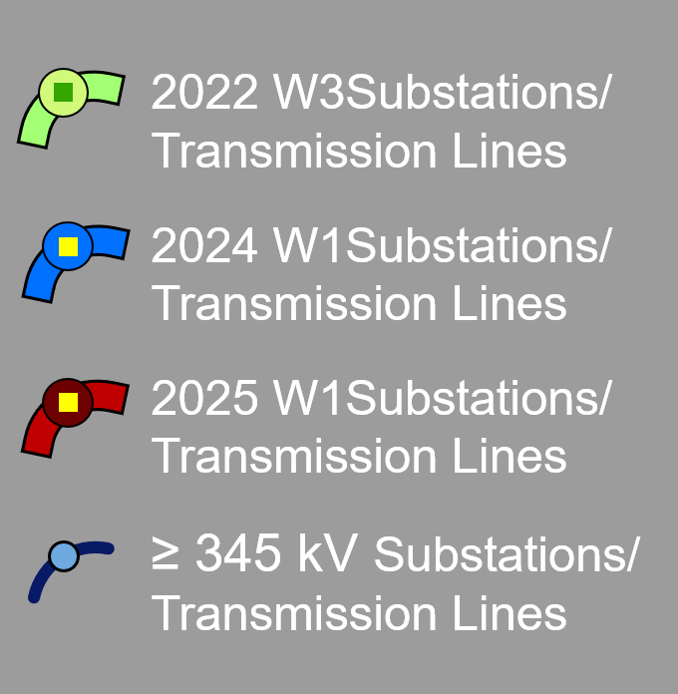
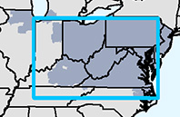
500 kV and Above Projects from 2025 RTEP Window 1,
2024 RTEP Window 1 and 2022 RTEP Window 3

Slide 18
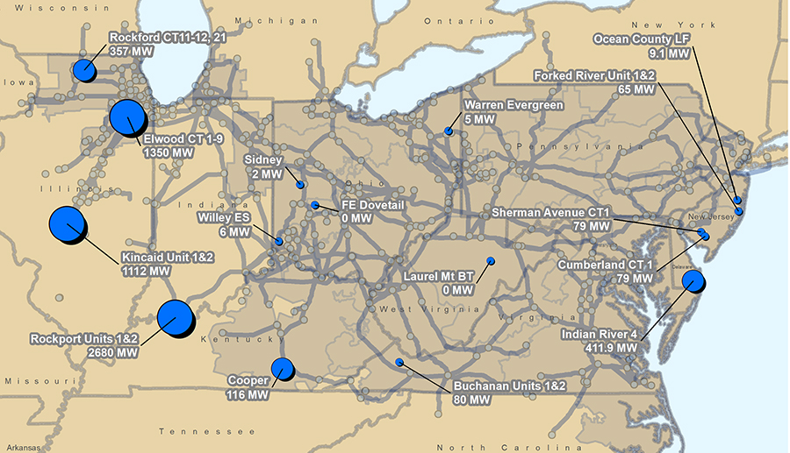
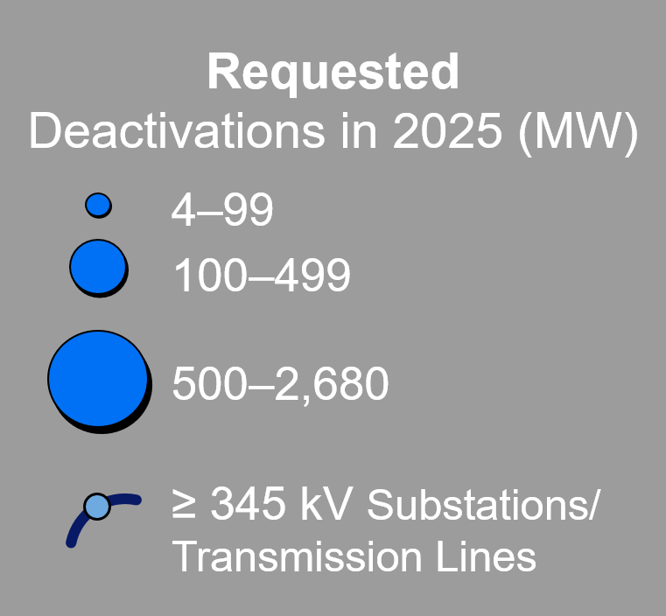
Deactivation Notifications Received in 2025

Slide 19
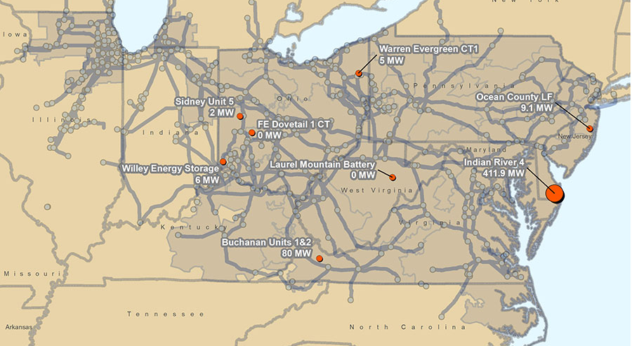
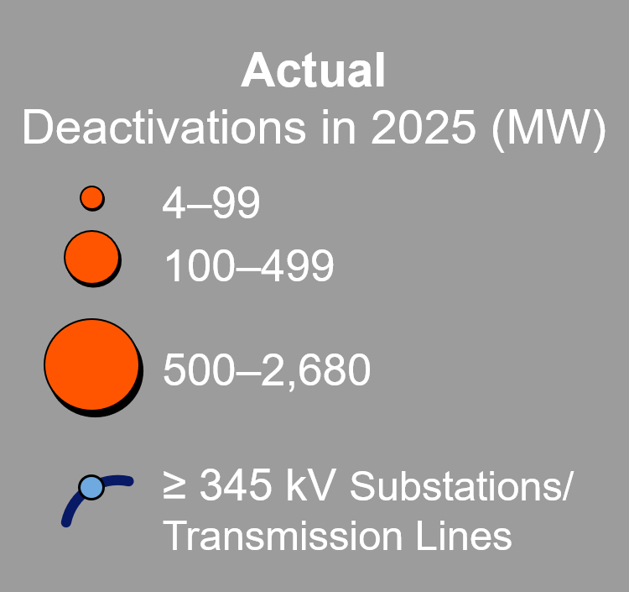
Deactivation Notifications Received in 2025

Slide 20
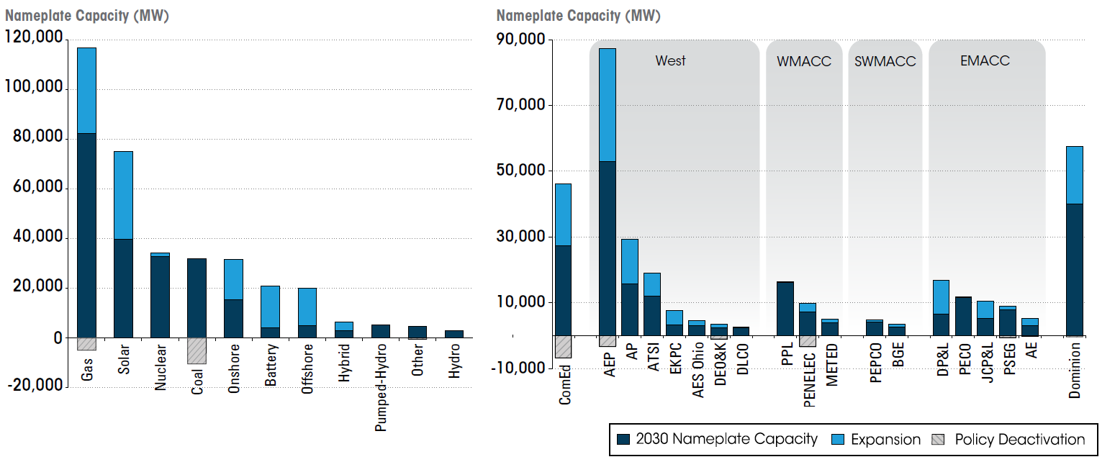
Economic Capacity Expansion

Slide 21
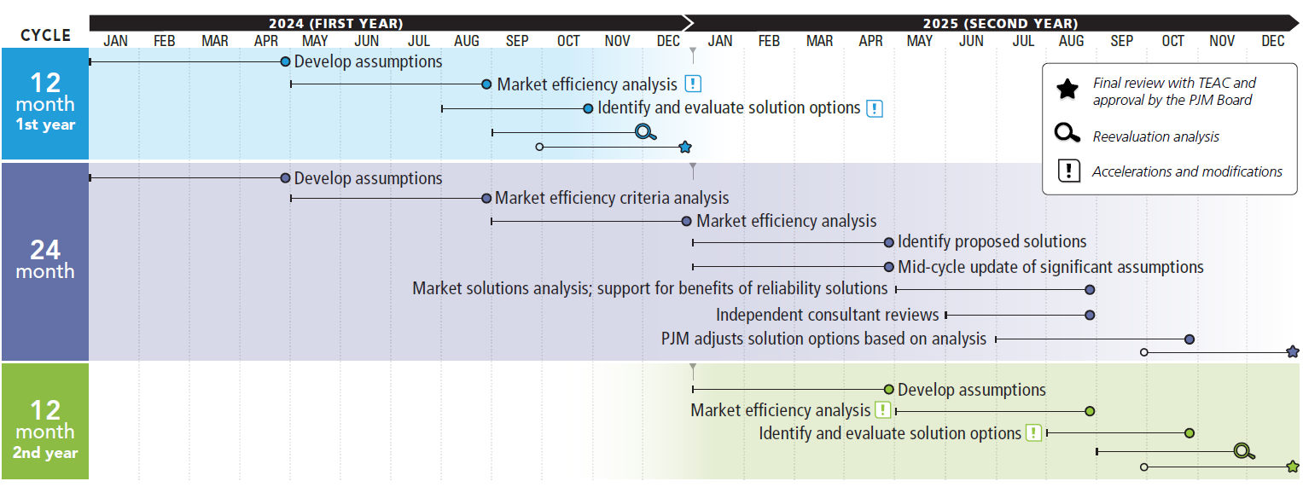
2024/2025 Market Efficiency 24-Month Cycle

Slide 22
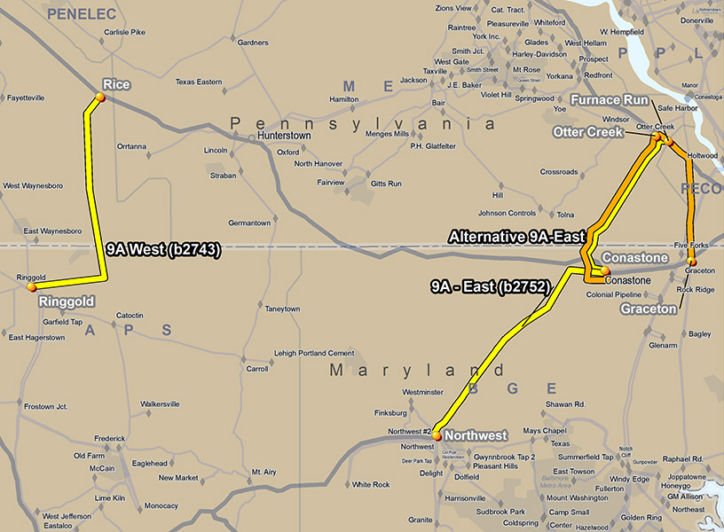
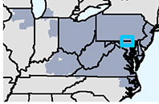
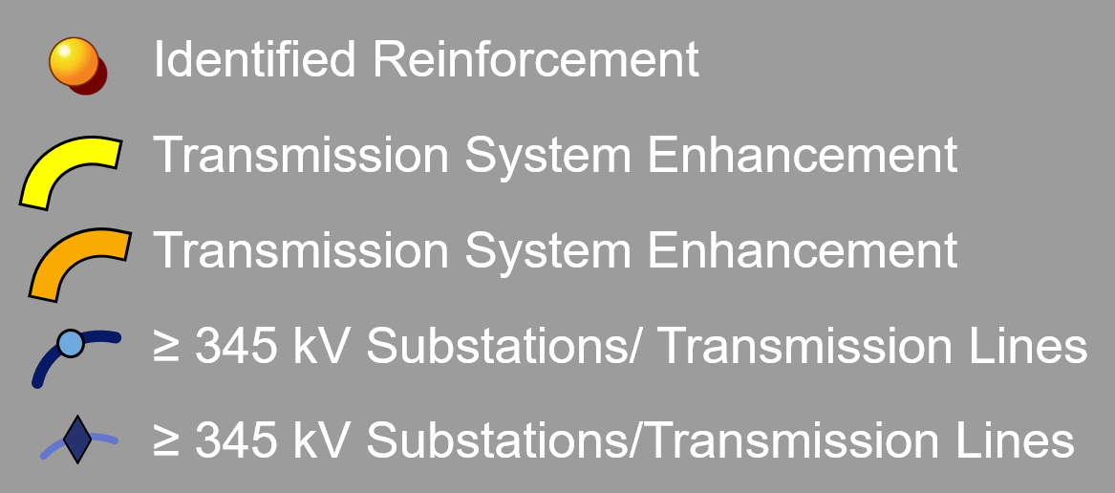
Project 9A – RTEP Baseline Project B2743 and B2752

Slide 23
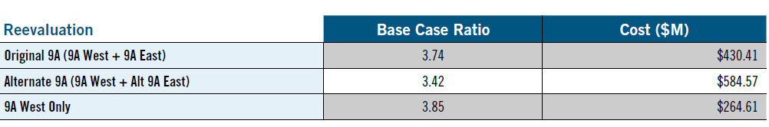
2025 Project 9A Reevaluation

Slide 24
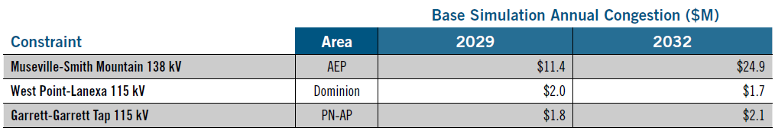
2024/2025 Long-Term Market Efficiency
Window Congestion Drivers

Slide 25
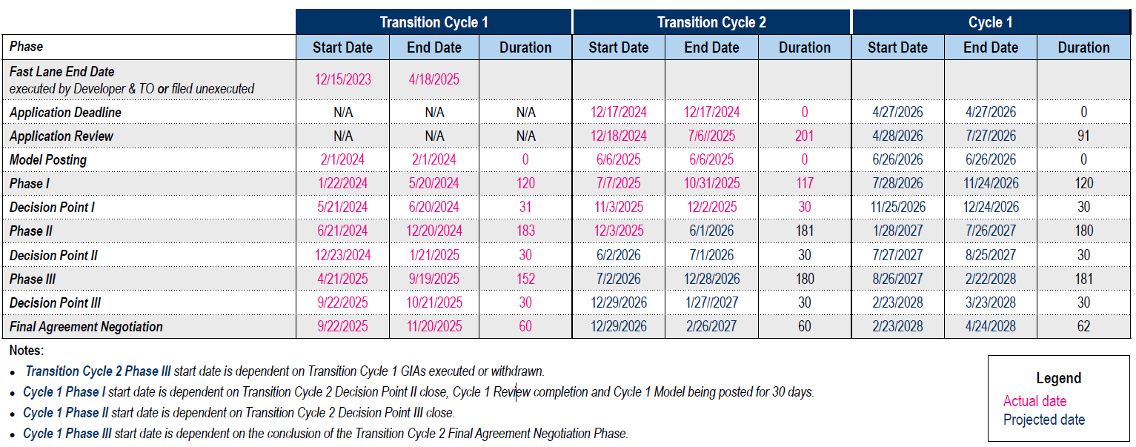
Interconnection Process Reform Timeline
(as of March 18, 2026, 10:21 a.m. EPT)

