Slide 1
2019 RTEP Report
Key Maps, Tables & Figures
The following set of slides provides key information from PJM’s 2019 RTEP cycle. The slides are provided for the reader’s own communications needs.

Slide 2
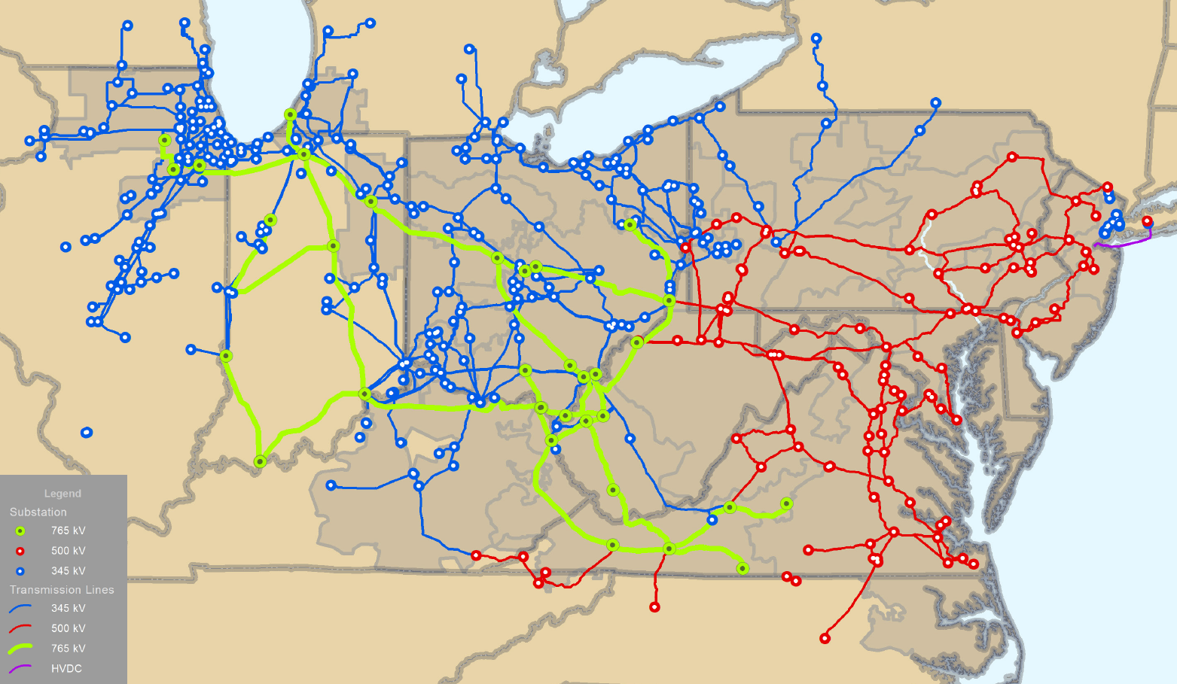
PJM Backbone Transmission System

Slide 3
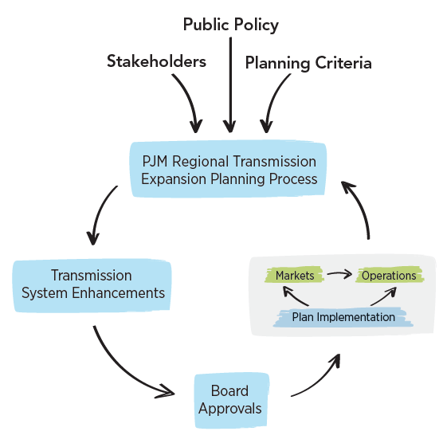
RTEP Process – RTO Perspective

Slide 4
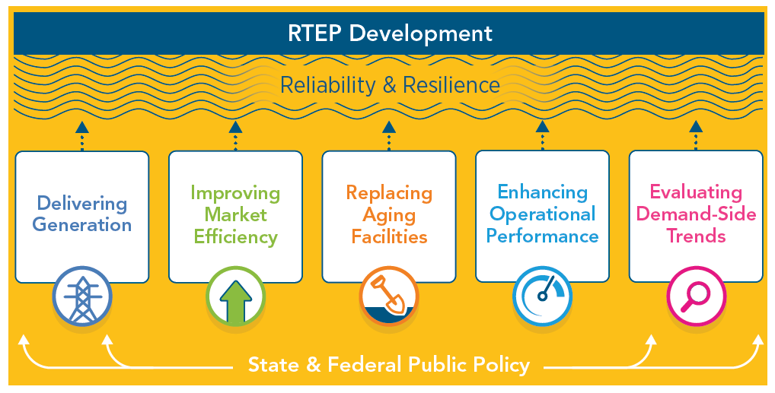
System Enhancement Drivers

Slide 5
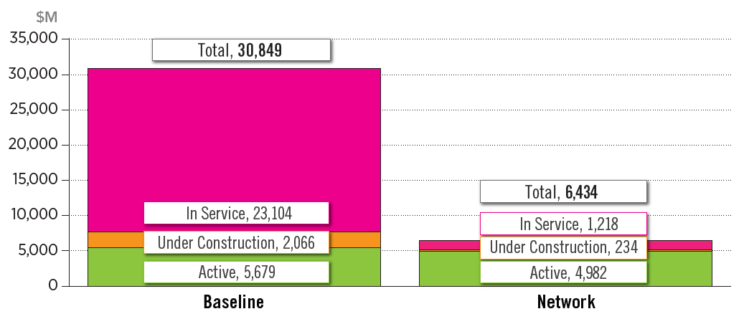
Board Approved RTEP Projects
(as of Dec. 31, 2019)

Slide 6
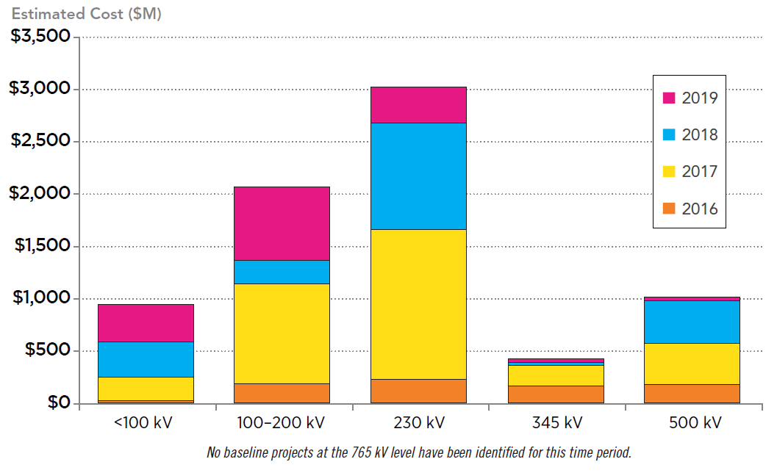
Approved Baseline Projects by Voltage
(2016-2019)

Slide 7
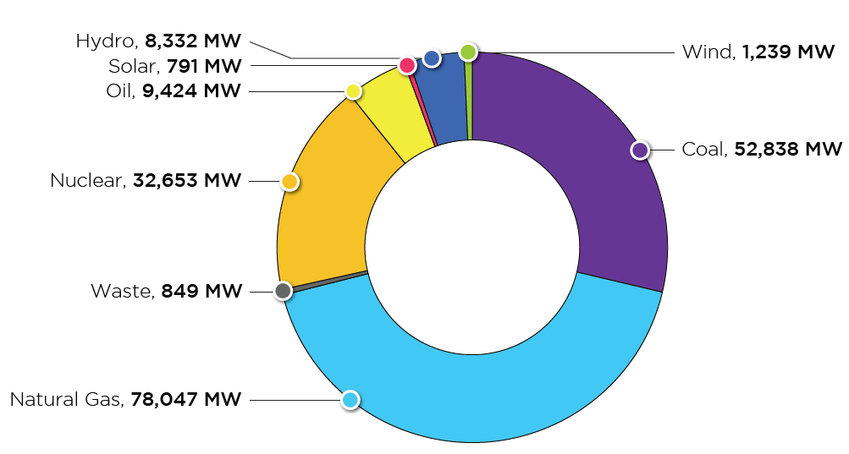
PJM Existing RPM-Eligible Installed Capacity Mix
(Dec. 31, 2019)

Slide 8
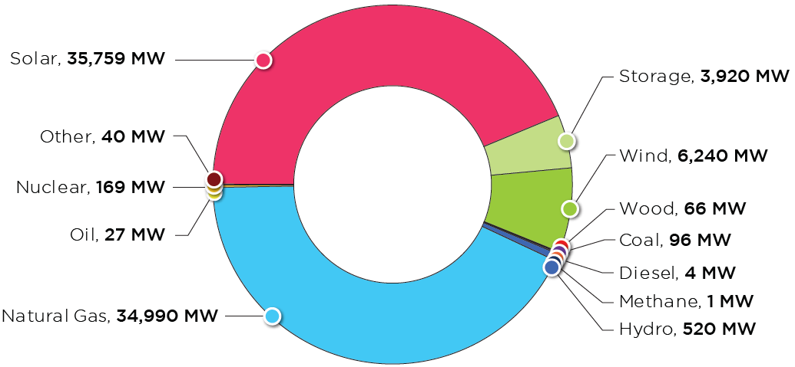
PJM Queued Generation Fuel Mix – Requested
Capacity Interconnection Rights
(Dec. 31, 2019)

Slide 9
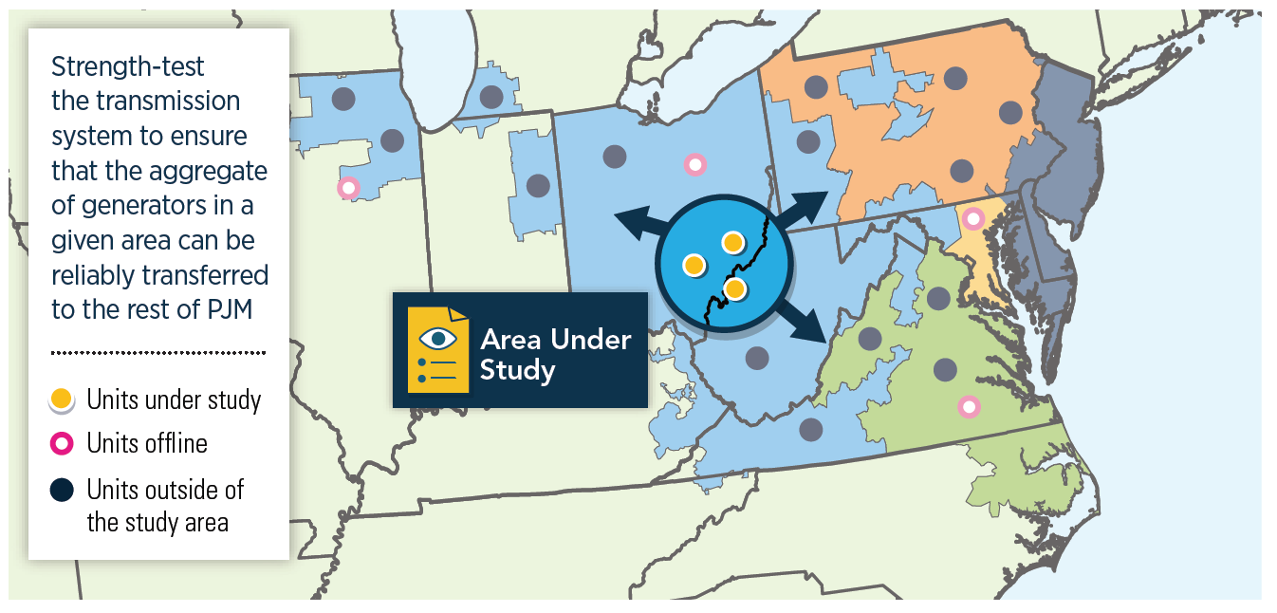
Generator Deliverability Concept

Slide 10
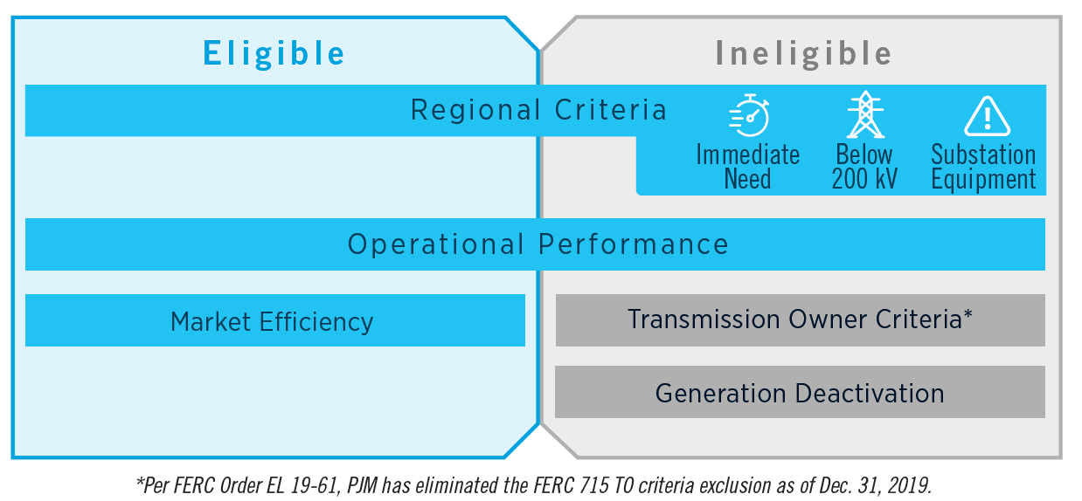
Window Eligibility

Slide 11
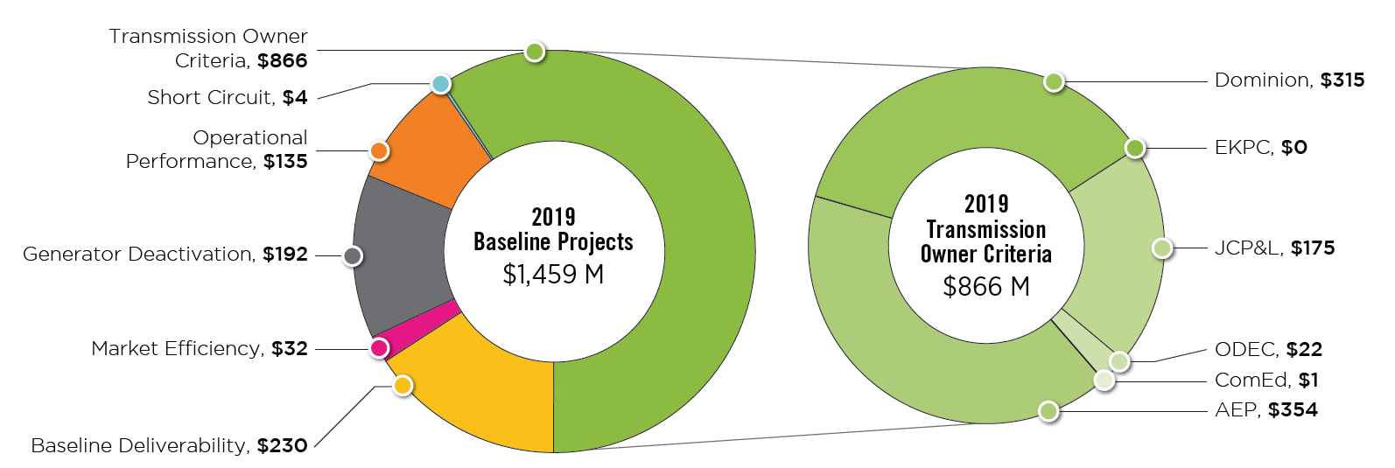
2019 RTEP Baseline Projects by Driver
($ Million)

Slide 12
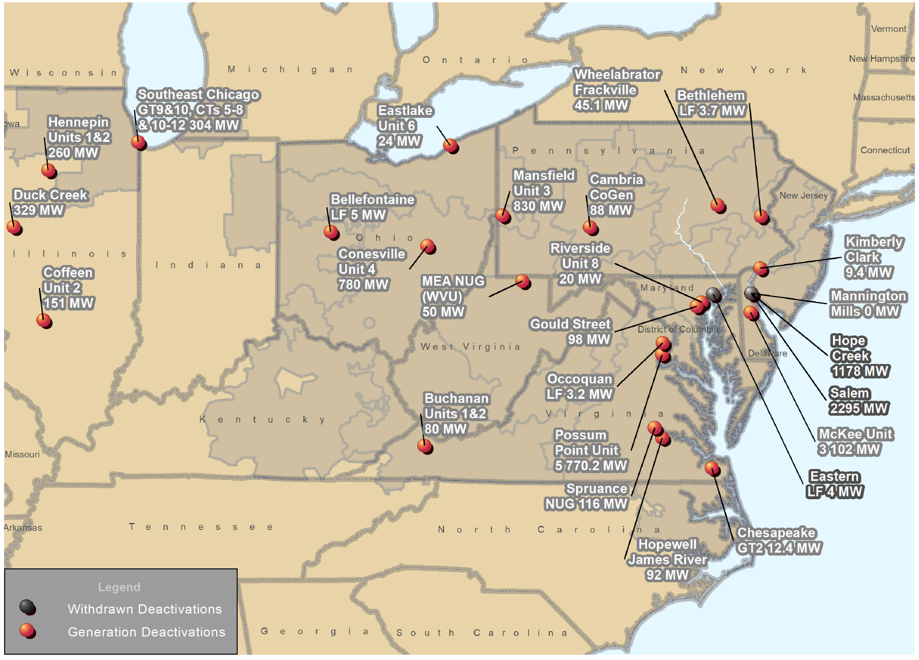
PJM Generator Deactivation Notifications Received
Jan. 1, 2019−Dec. 31, 2019

Slide 13
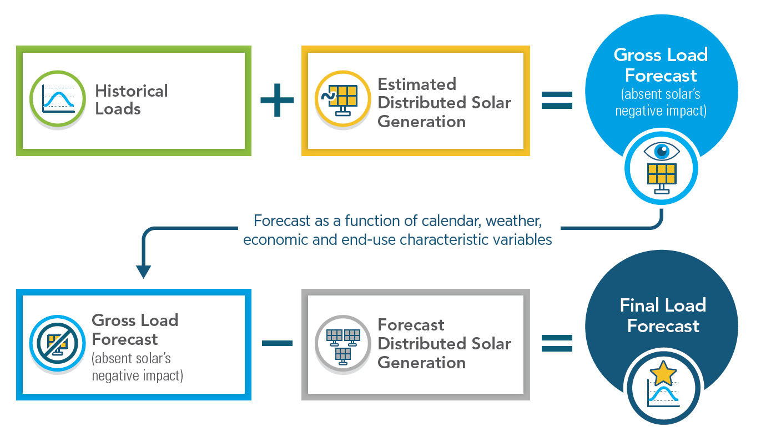
Accounting for Distributed Solar Generation

Slide 14
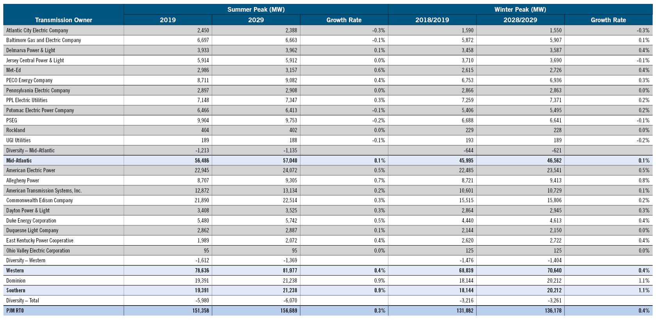
2019 Load Forecast Report

Slide 15
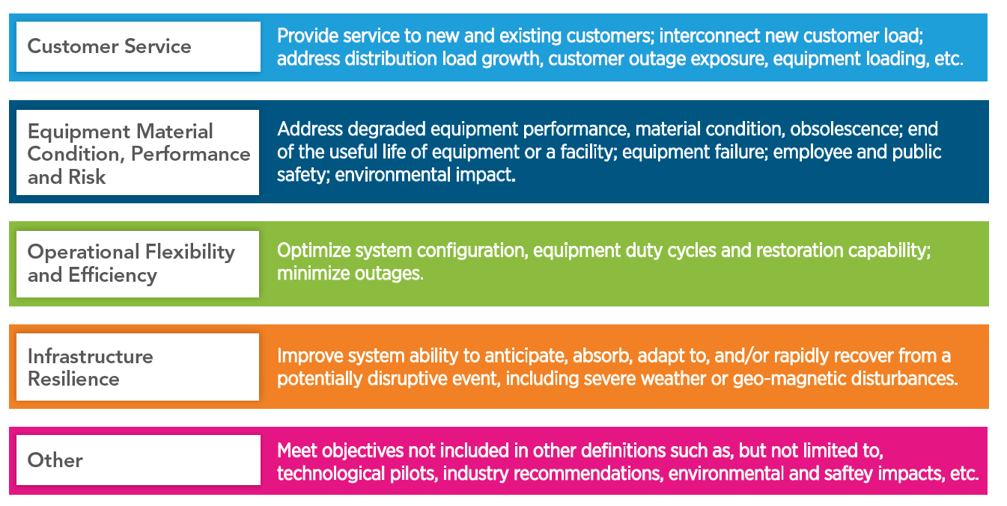
Primary Supplemental Project Drivers

Slide 16
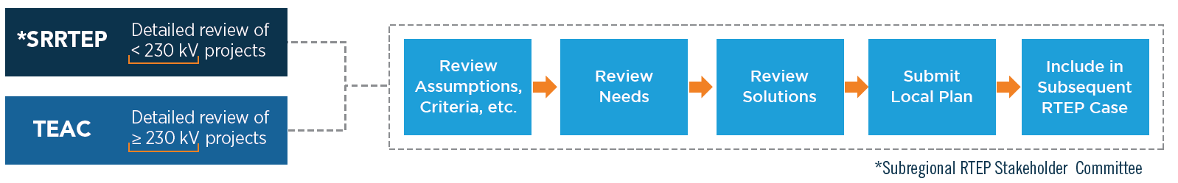
Attachment M3 Process for Supplemental Projects

Slide 17
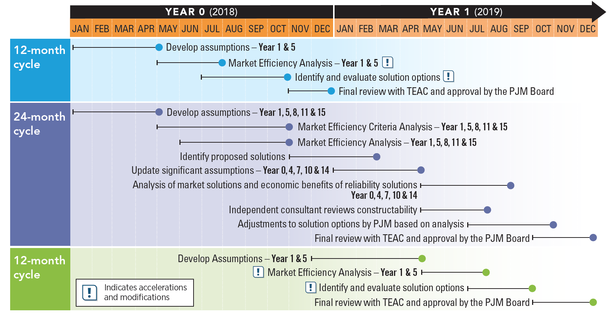
Market Efficiency 24-Month Cycle

Slide 18
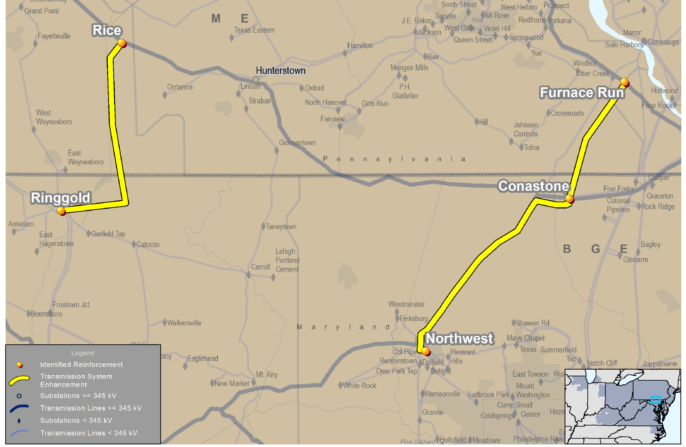
Project 9A – RTEP Baseline Projects B2743 & B2752

Slide 19

Project 5E – RTEP Baseline Project B2992

Slide 20
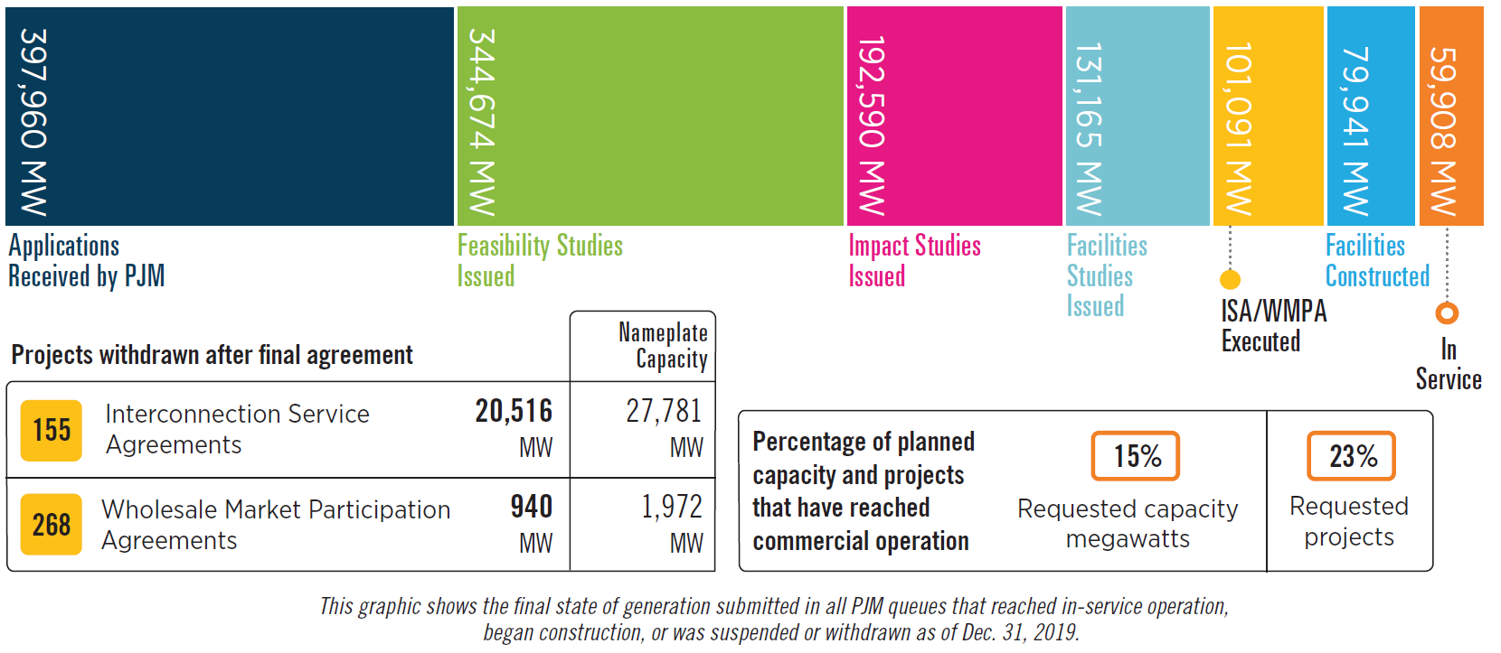
Queued Generation Progression

Slide 21
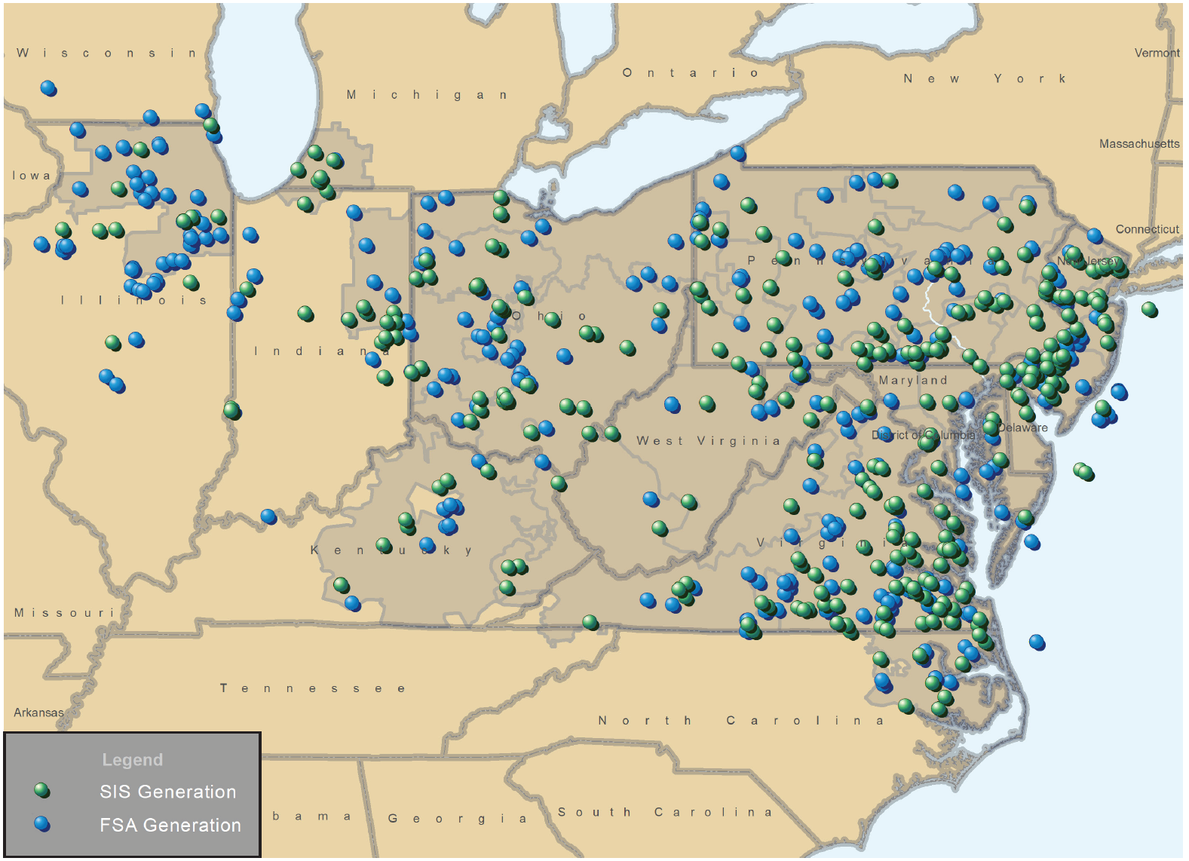
Feasibility and System Impact Studies Performed in 2019

Slide 22
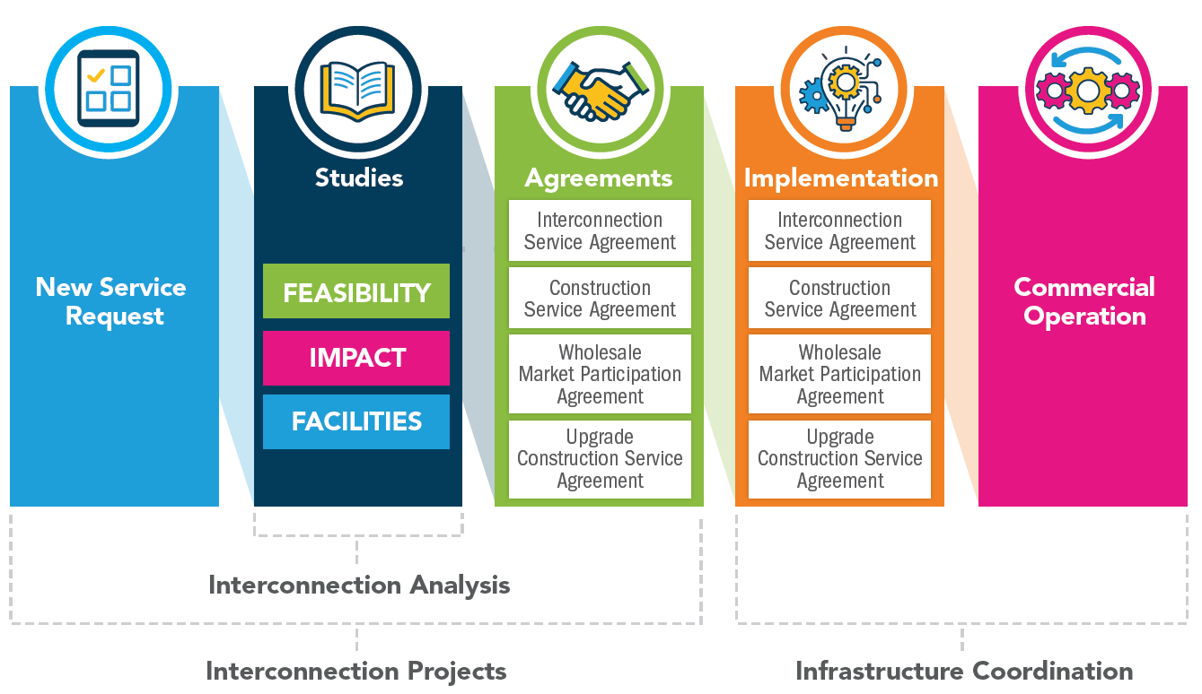
Queue Process Overview

