Slide 1
2022 RTEP Report
Key Maps, Tables & Figures
The following set of slides provides key information from PJM’s 2022 RTEP cycle. The slides are provided for the reader’s own communications needs.

Slide 2
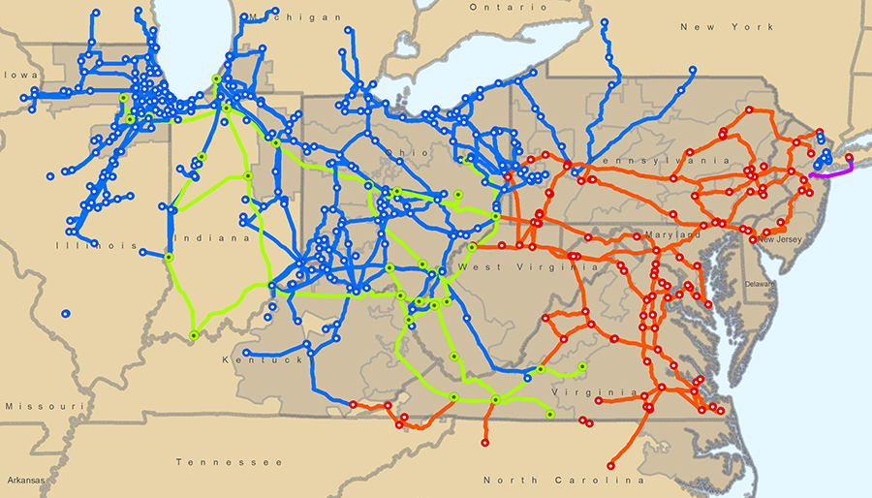
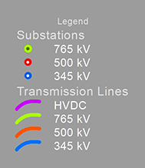
PJM Backbone Transmission System

Slide 3
Board-Approved RTEP Projects
(as of Dec. 31, 2022)
Notes:
Herman 3/1/2023

Slide 4
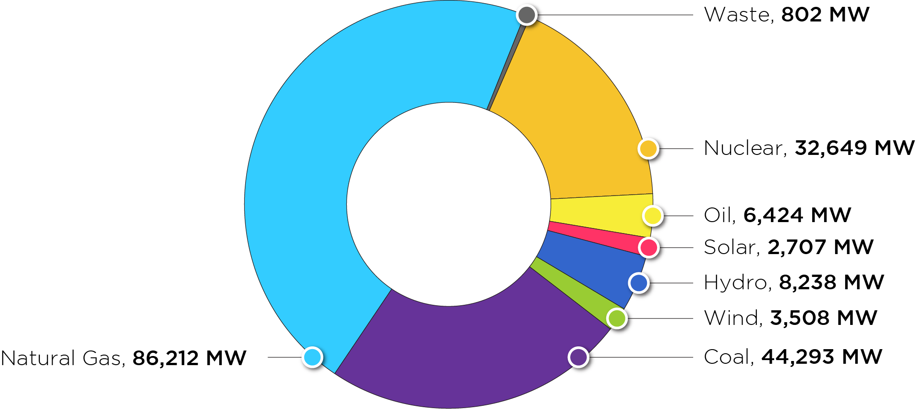
PJM Existing RPM-Eligible Installed Capacity Mix
As of Dec. 31, 2022
Notes:
Herman – updated Feb. 2023

Slide 5
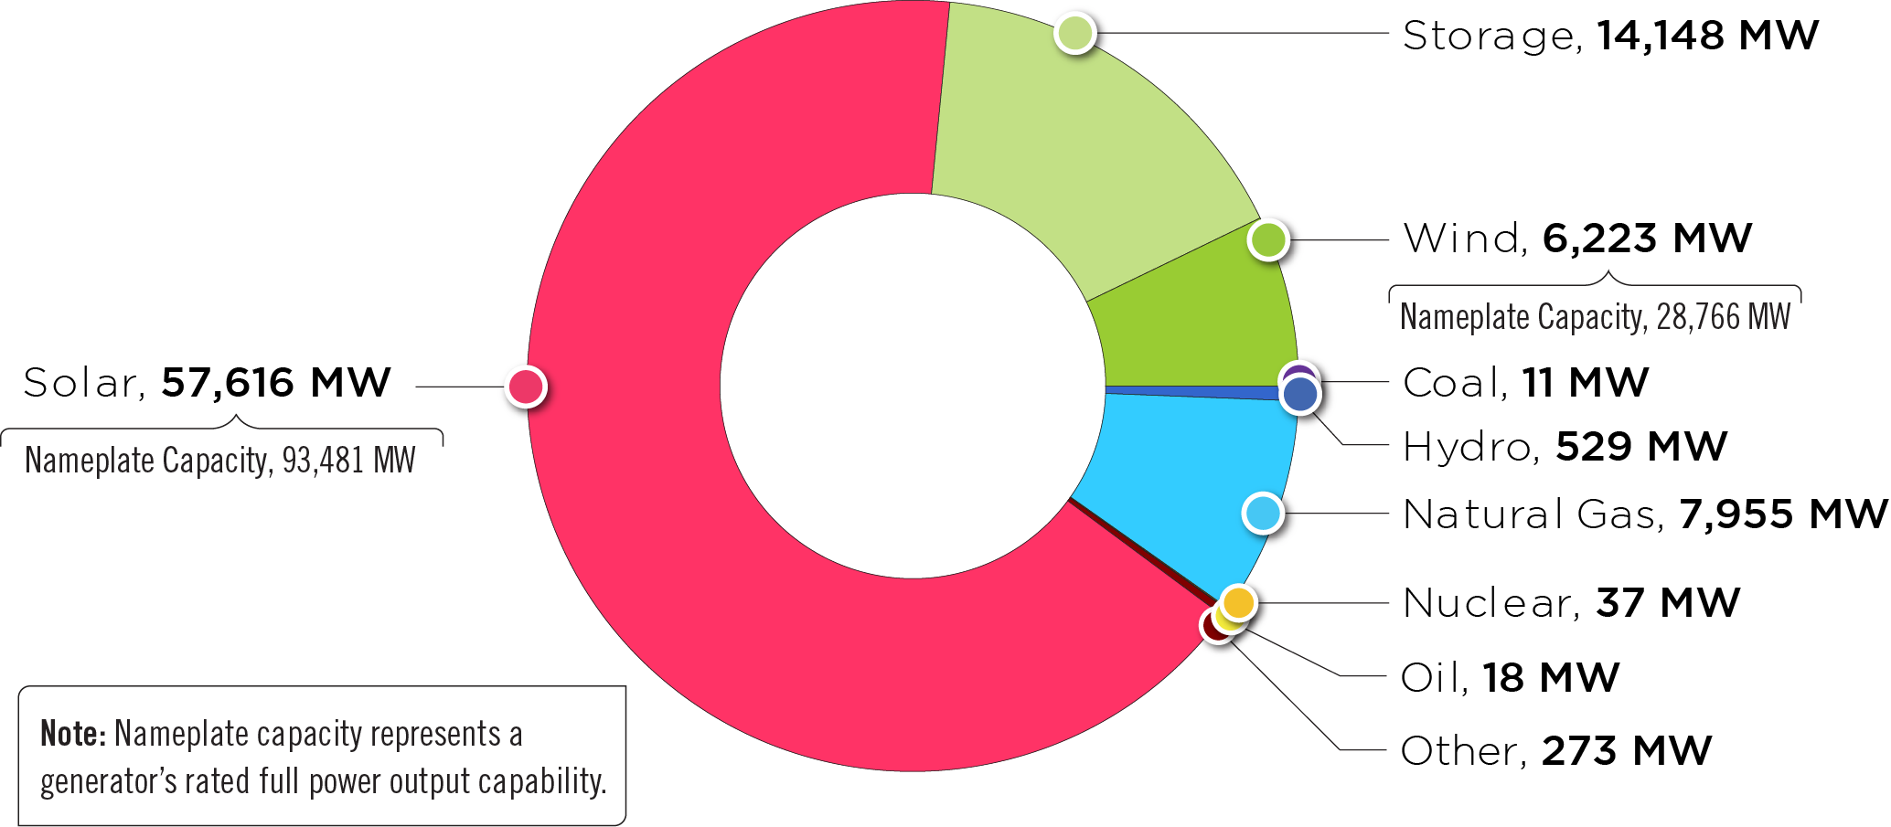
Queued Generation Fuel Mix –
Requested Capacity Interconnection Rights
As of Dec. 31, 2022
Notes:
Herman – updated Feb. 2023

Slide 6
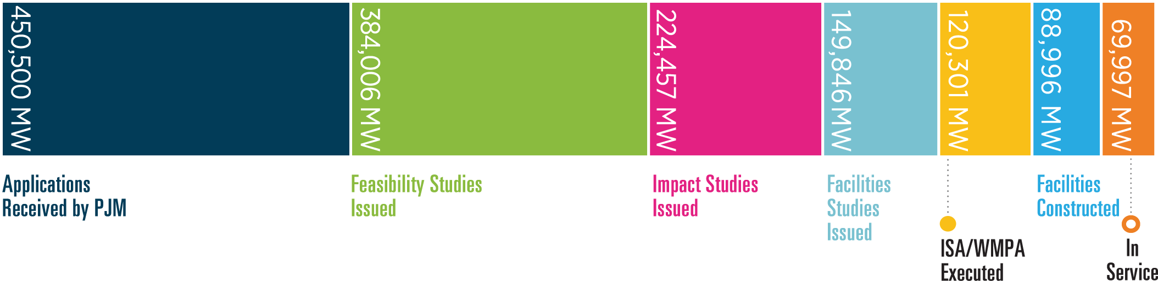
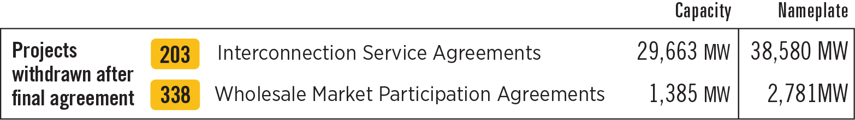
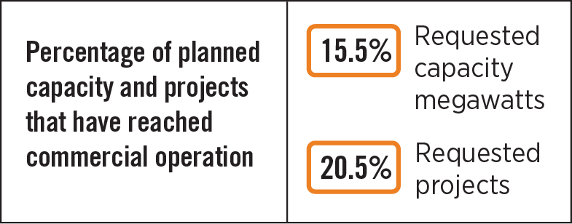
Queued Generation Progression –
Requested Capacity Interconnection Rights (Dec. 31, 2022)
This figure shows, historically, how far generation requests had proceeded in the interconnection process before they exited active participation (i.e., before they reached in-service status, began construction, were suspended or withdrew). The graphic does not include projects considered active in the queue as of Dec. 31, 2022.
Notes:
Feb. 22, 2022 herman

Slide 7
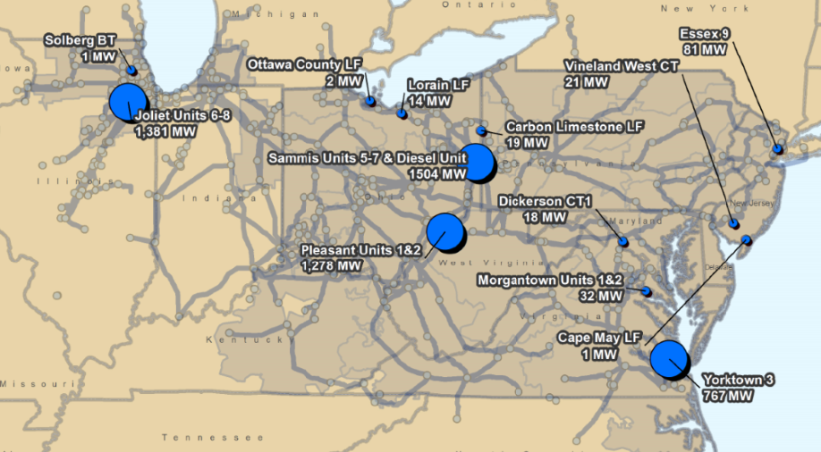
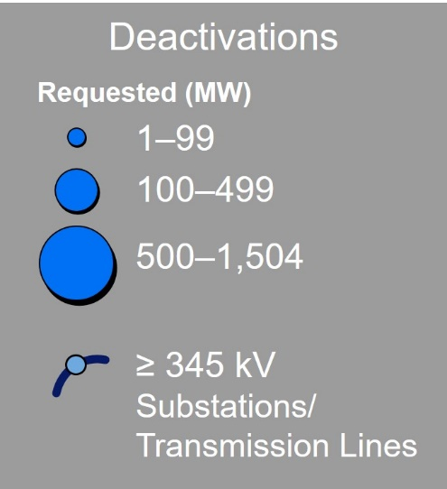
PJM Generator Deactivation Notifications Received
Jan. 1 to Dec. 31, 2022

Slide 8
2022 RTEP Baseline Projects by Driver
($ Million)
Notes:
Herman 3/1/2023

Slide 9
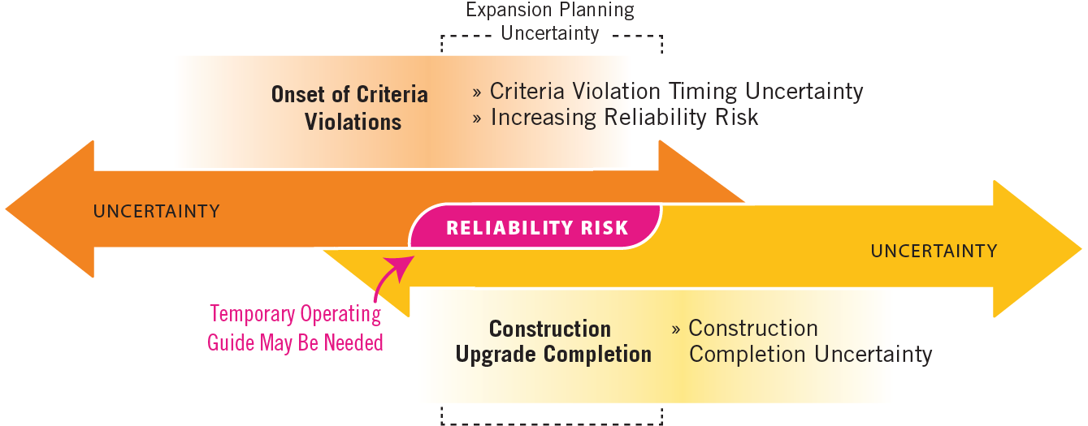
Transmission Expansion Uncertainty

Slide 10
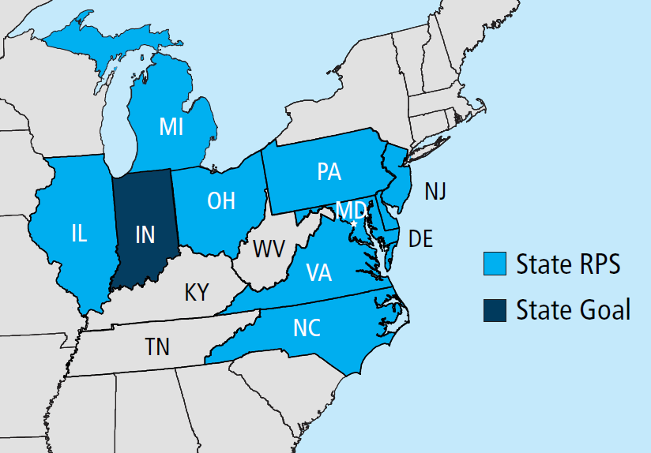
PJM State RPS Targets and Goals
State RPS Targets*
☼ | NJ: 50% by 2030** | ☼ | PA: 18% by 2021*** |  | OH: 8.5% by 2026
☼ | MD: 50% by 2030** | ☼ | IL: 50% by 2040 |  | MI: 15% by 2021
☼ | DE: 40% by 2035 | ☼ | VA: 100% by 2045/2050 (IOUs) |  | IN: 10% by 2025***
☼ | DC: 100% by 2032 | ☼ | NC: 12.5% by 2021 (IOUs)
☼ Minimum solar requirement * Targets may change over time; these are recent representative snapshot values ** Includes an additional 2.5% of Class II resources each year *** Includes non-renewable “alternative” energy resources

Slide 11
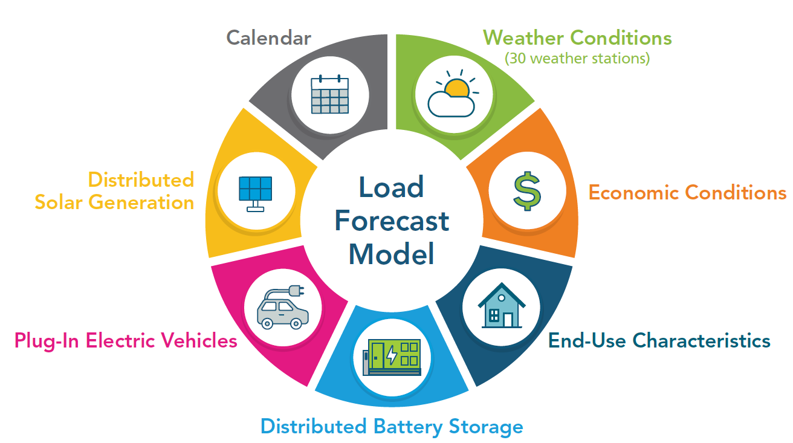
Load Forecast Model

Slide 12
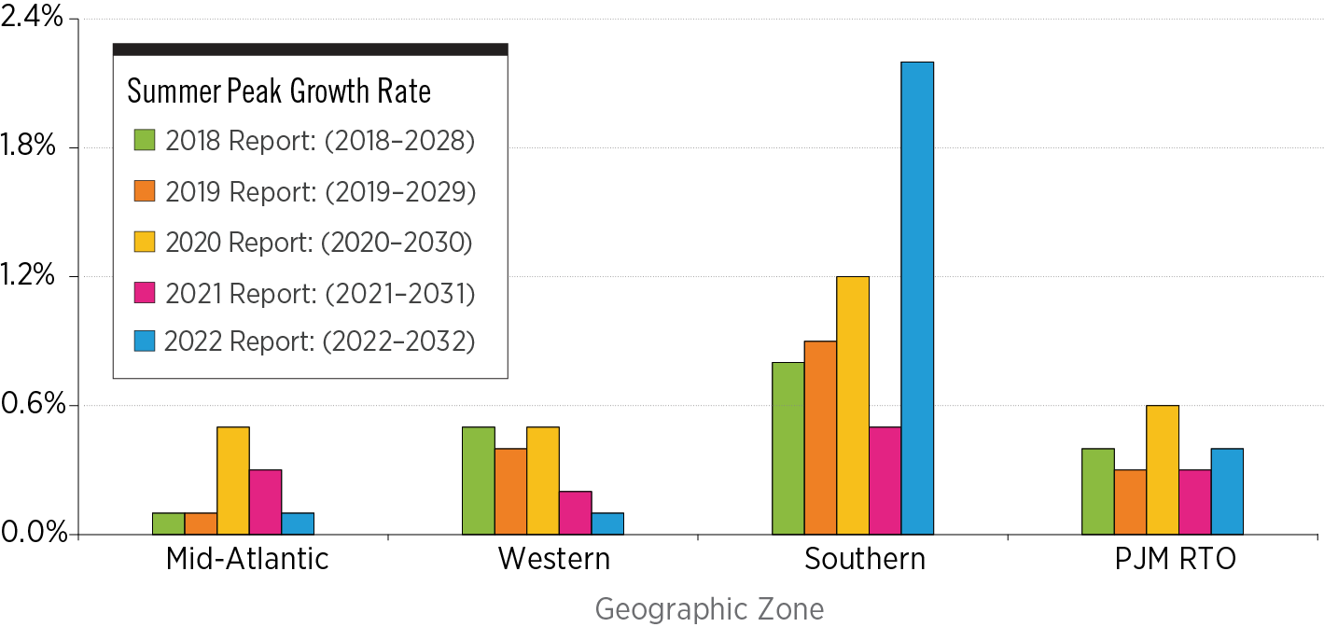
10-Year Summer Peak Load Growth Rate Comparison

Slide 13
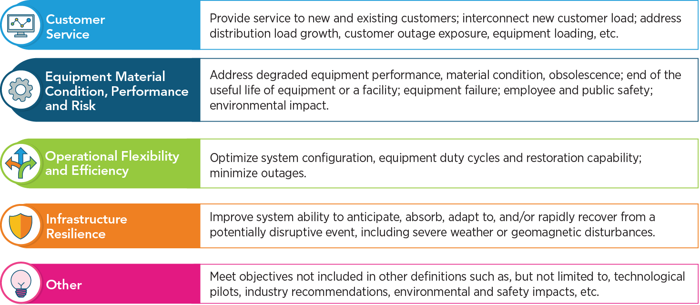
Primary Supplemental Project Drivers

Slide 14
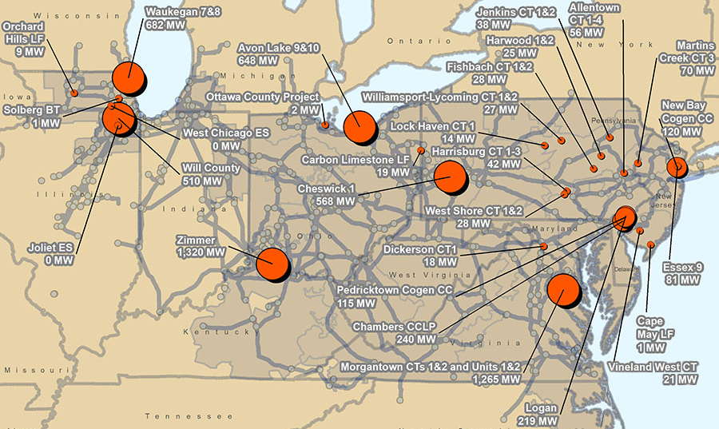
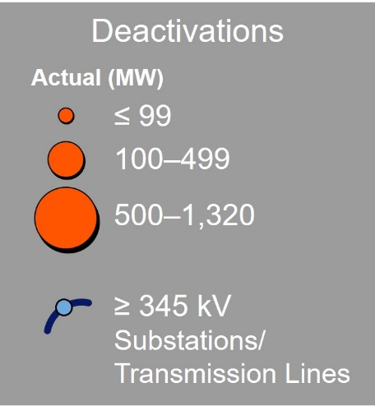
PJM Actual Generator Deactivations
Jan. 1 to Dec. 31, 2022

Slide 15
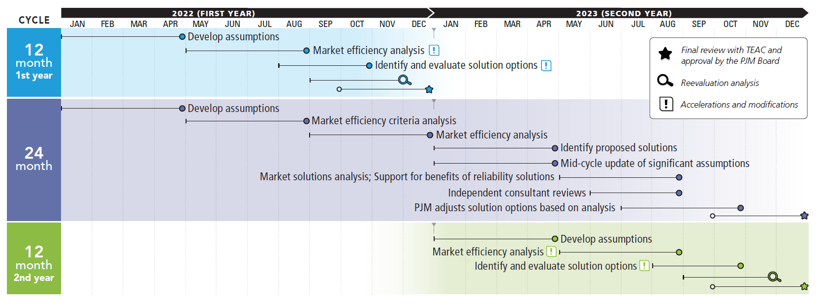
2022/2023 Market Efficiency 24-Month Cycle

Slide 16
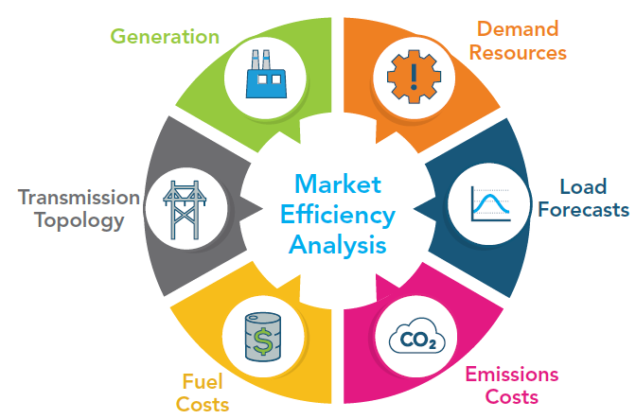
Market Efficiency Analysis Parameters

Slide 17
New Services Queue Process Request

Slide 18
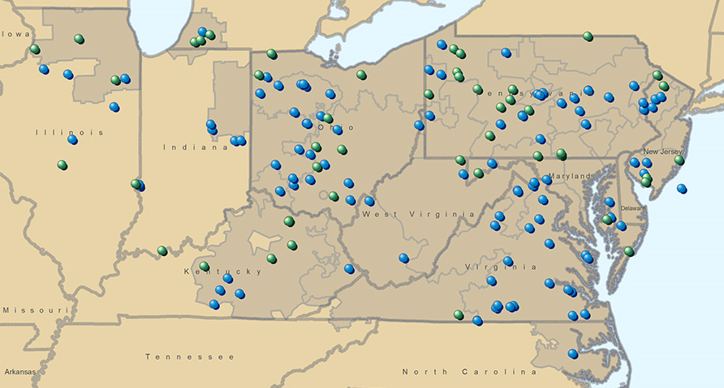
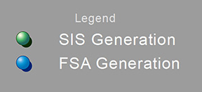
Feasibility and System Impact Studies Performed in 2022

Slide 19
Potential Options for the New Jersey Offshore Wind
Transmission Solution

Slide 20
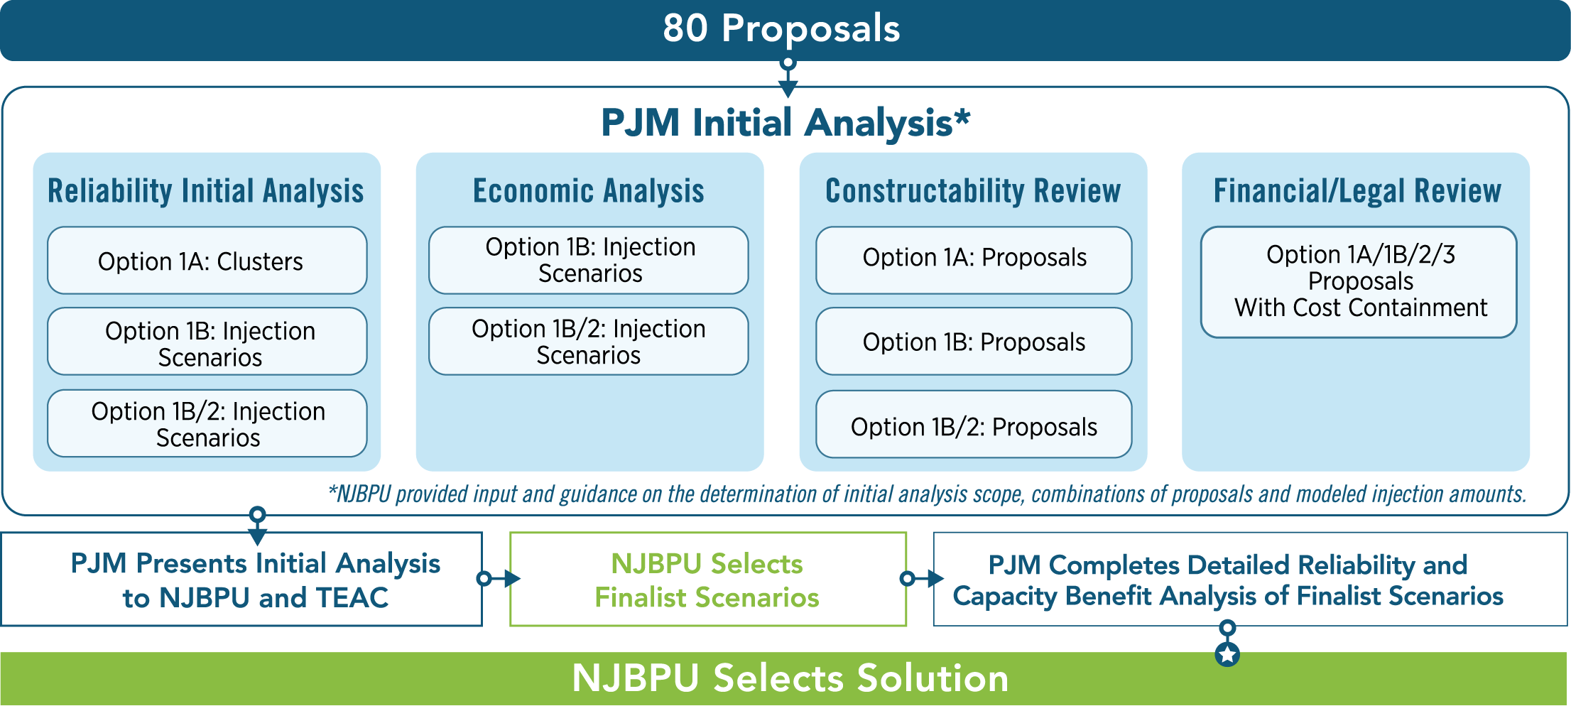
New Jersey SAA Offshore Wind Evaluation
Process Overview

